Slide 1
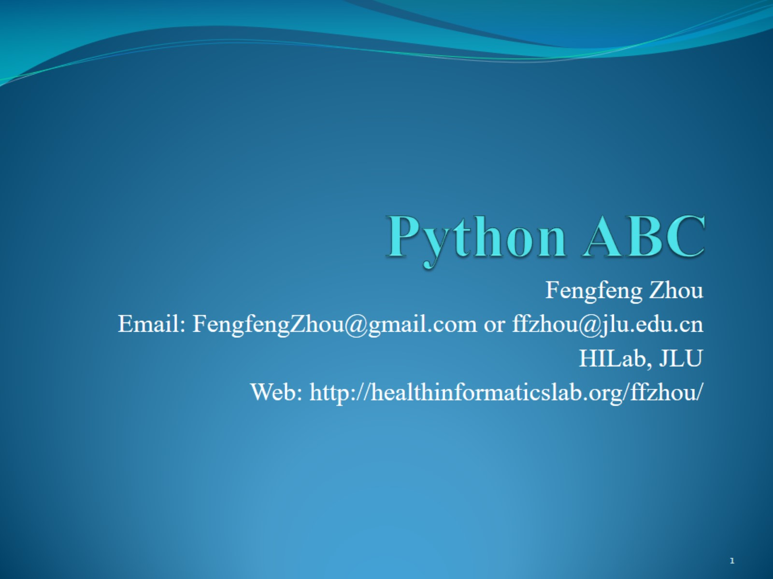
Python ABC

Slide 2
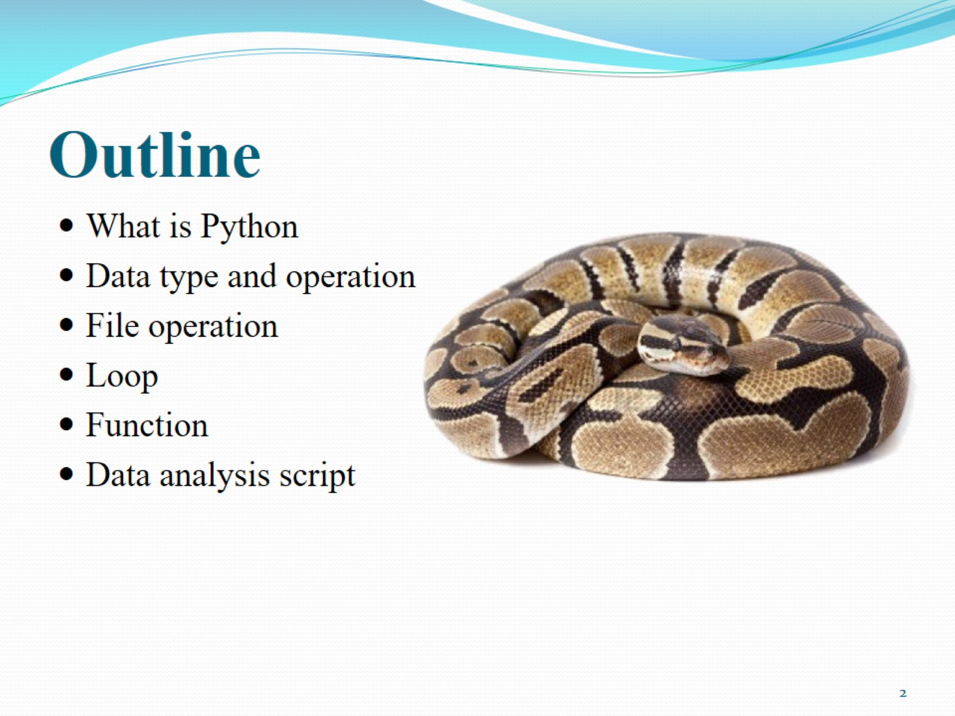
Outline

Slide 3
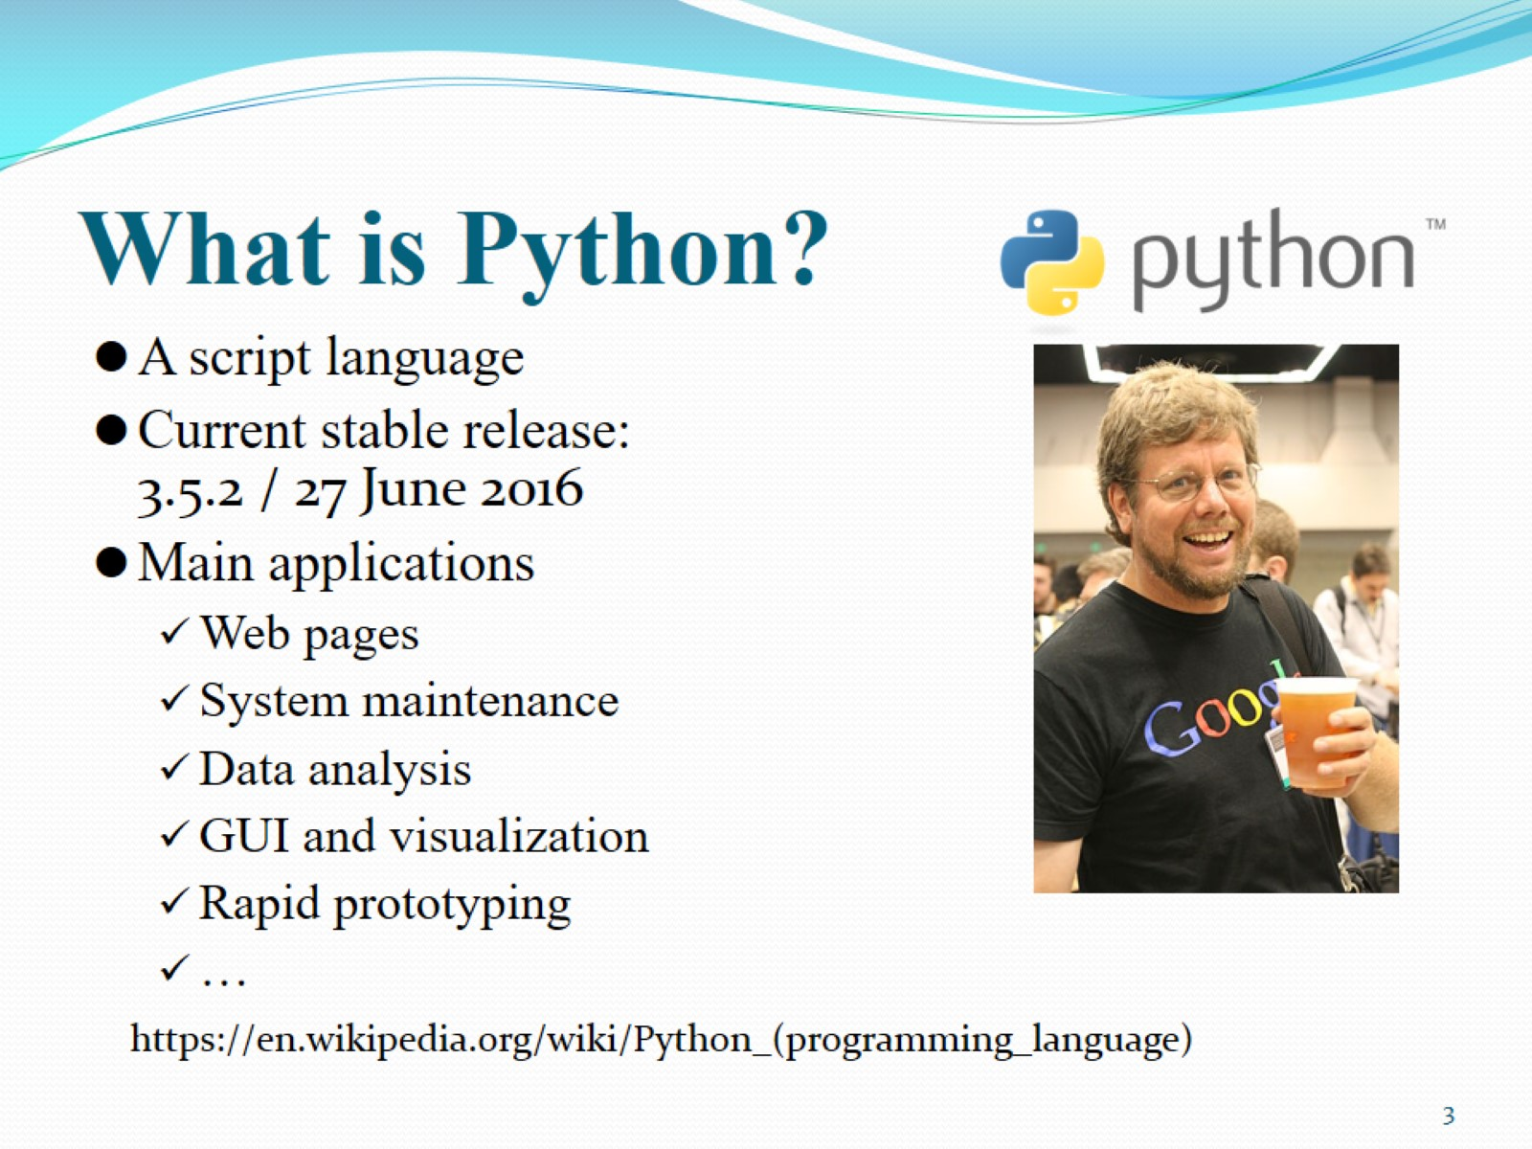
What is Python?

Slide 4
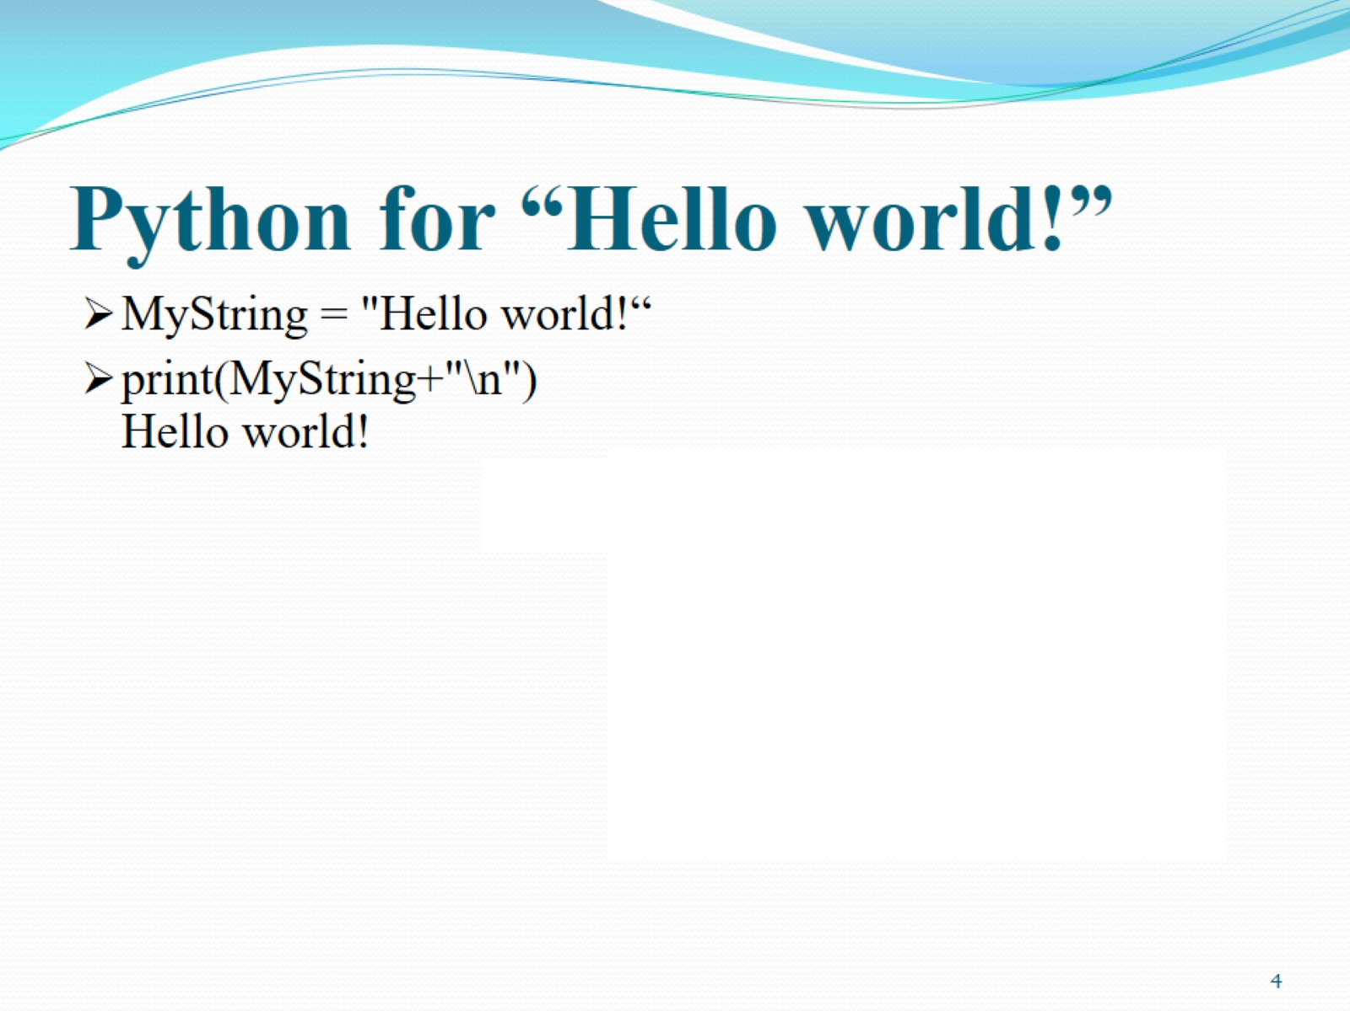
Python for “Hello world!”

Slide 5
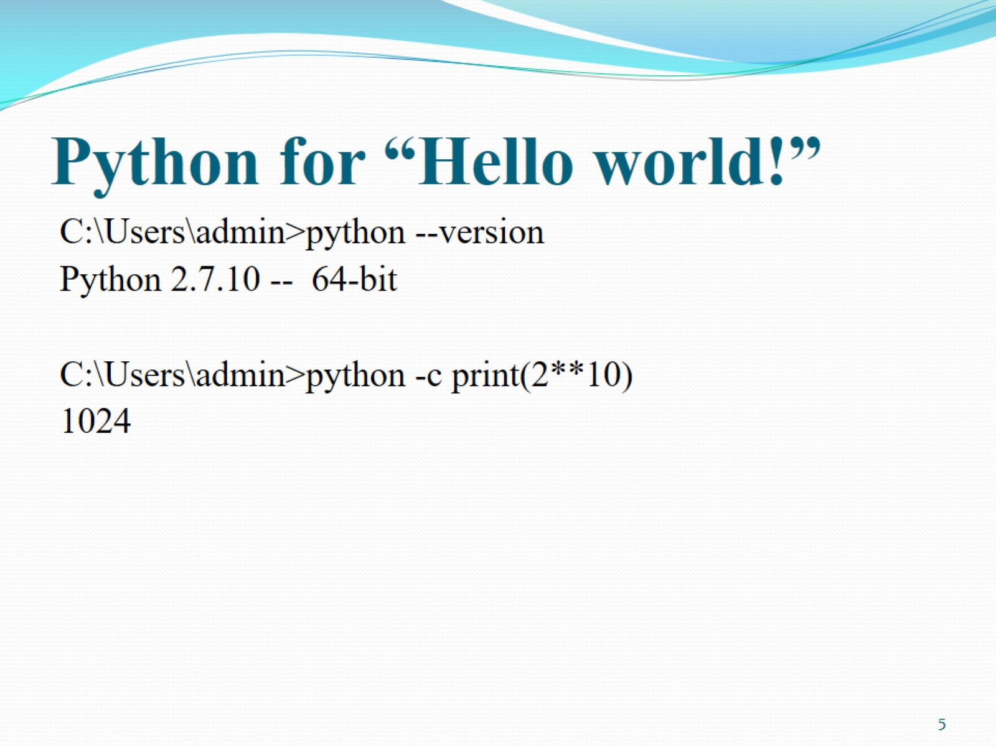
Python for “Hello world!”

Slide 6
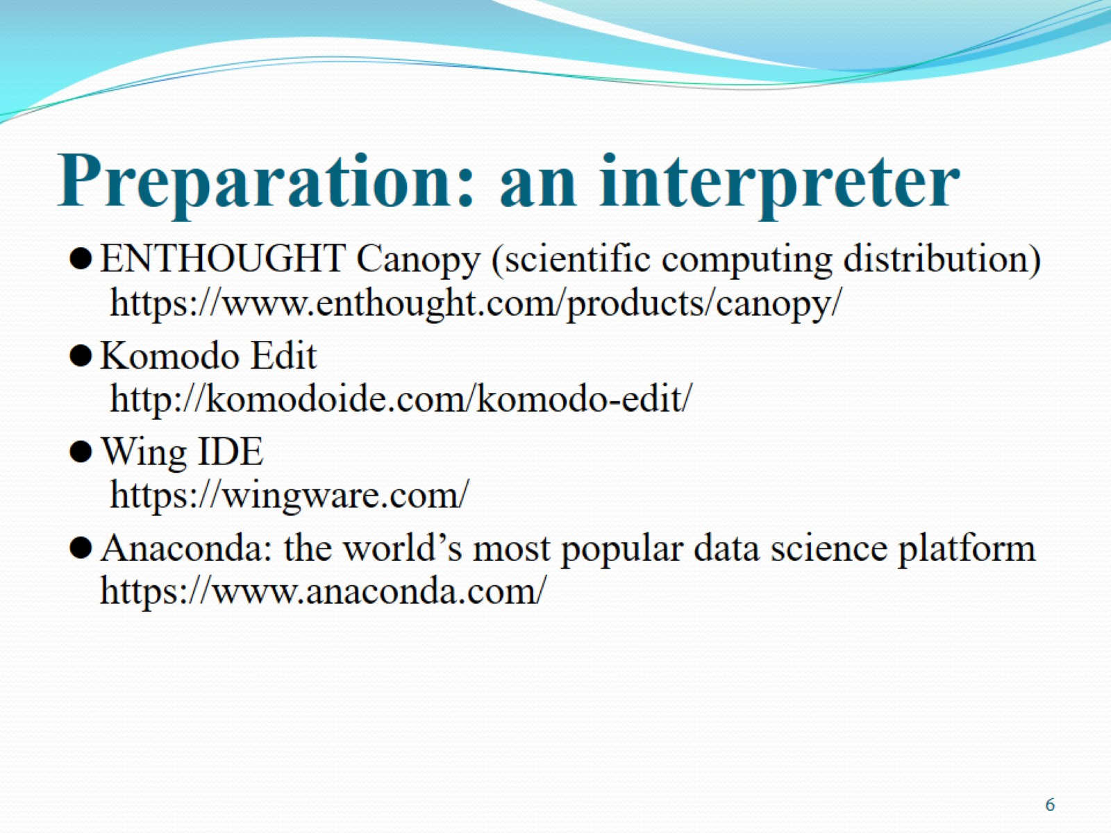
Preparation: an interpreter

Slide 7
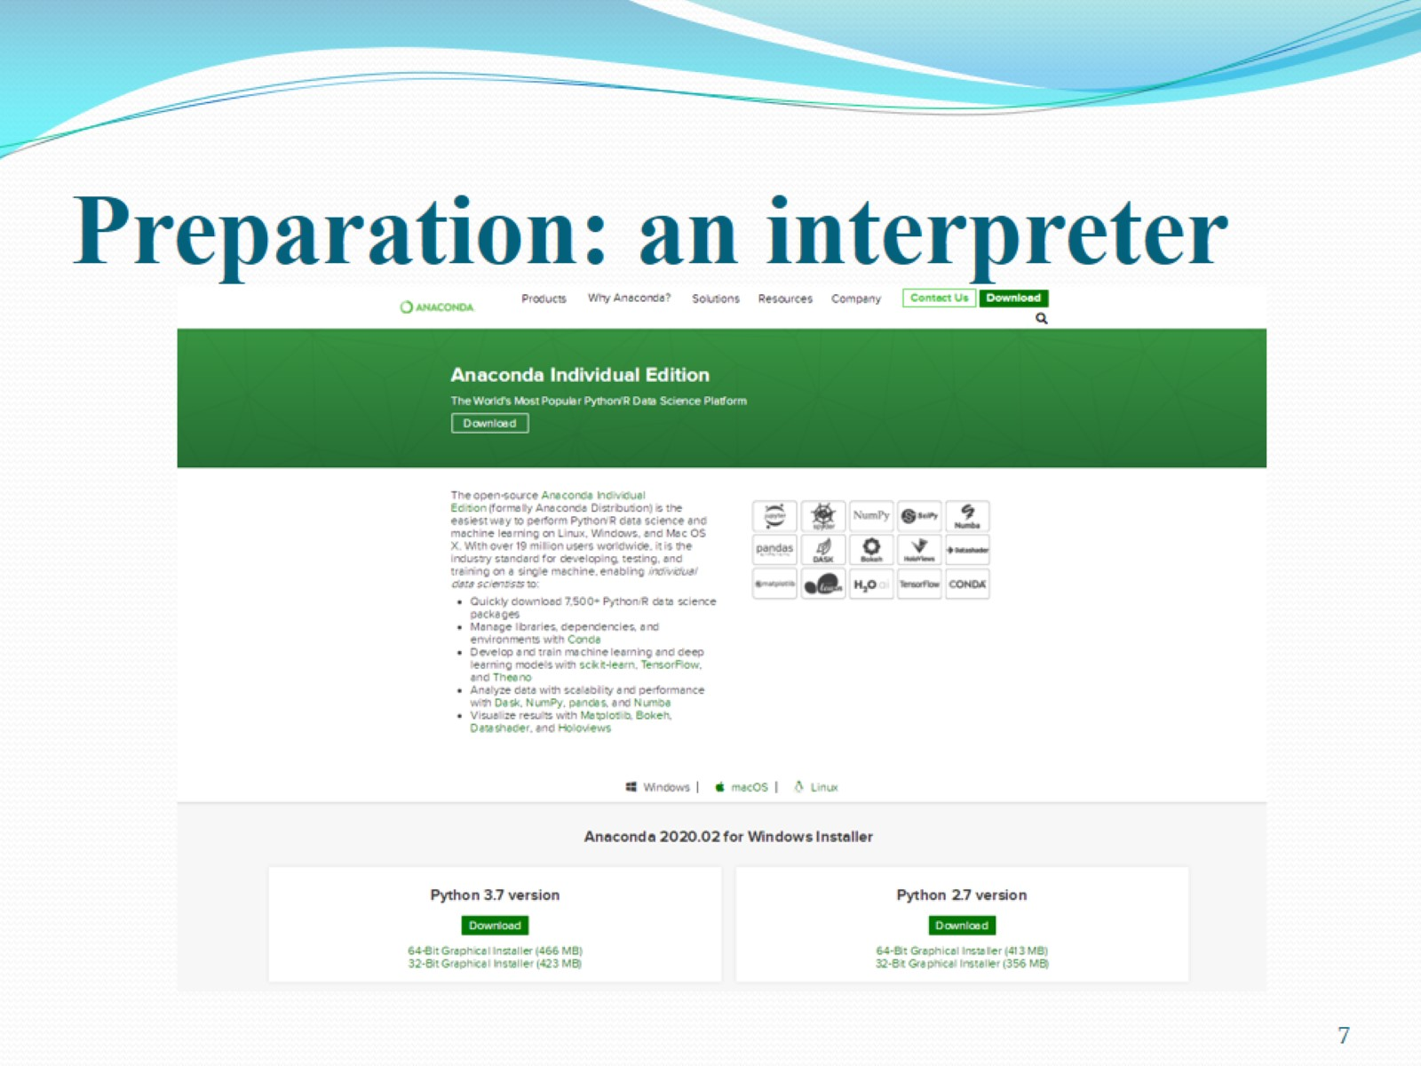
Preparation: an interpreter

Slide 8
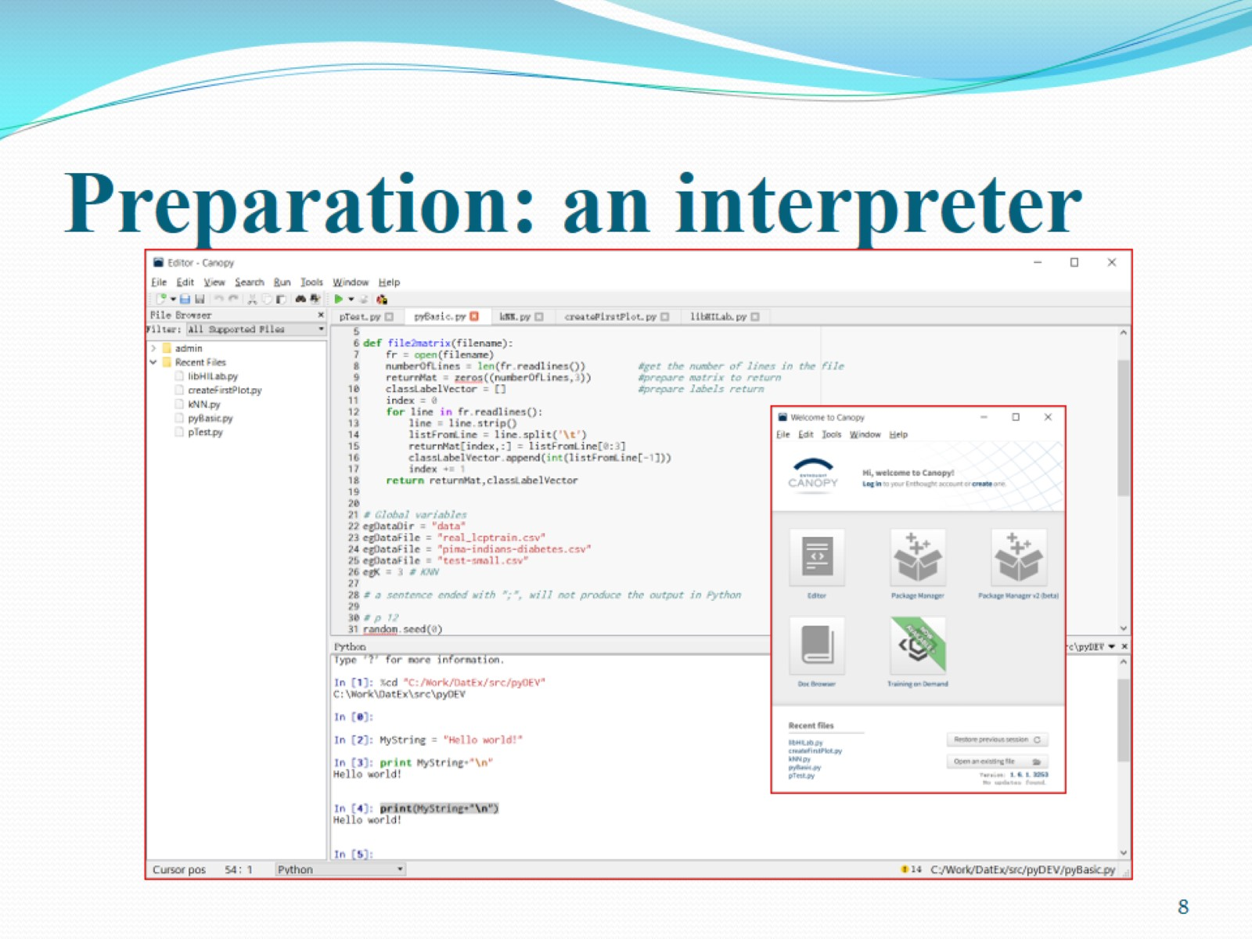
Preparation: an interpreter

Slide 9
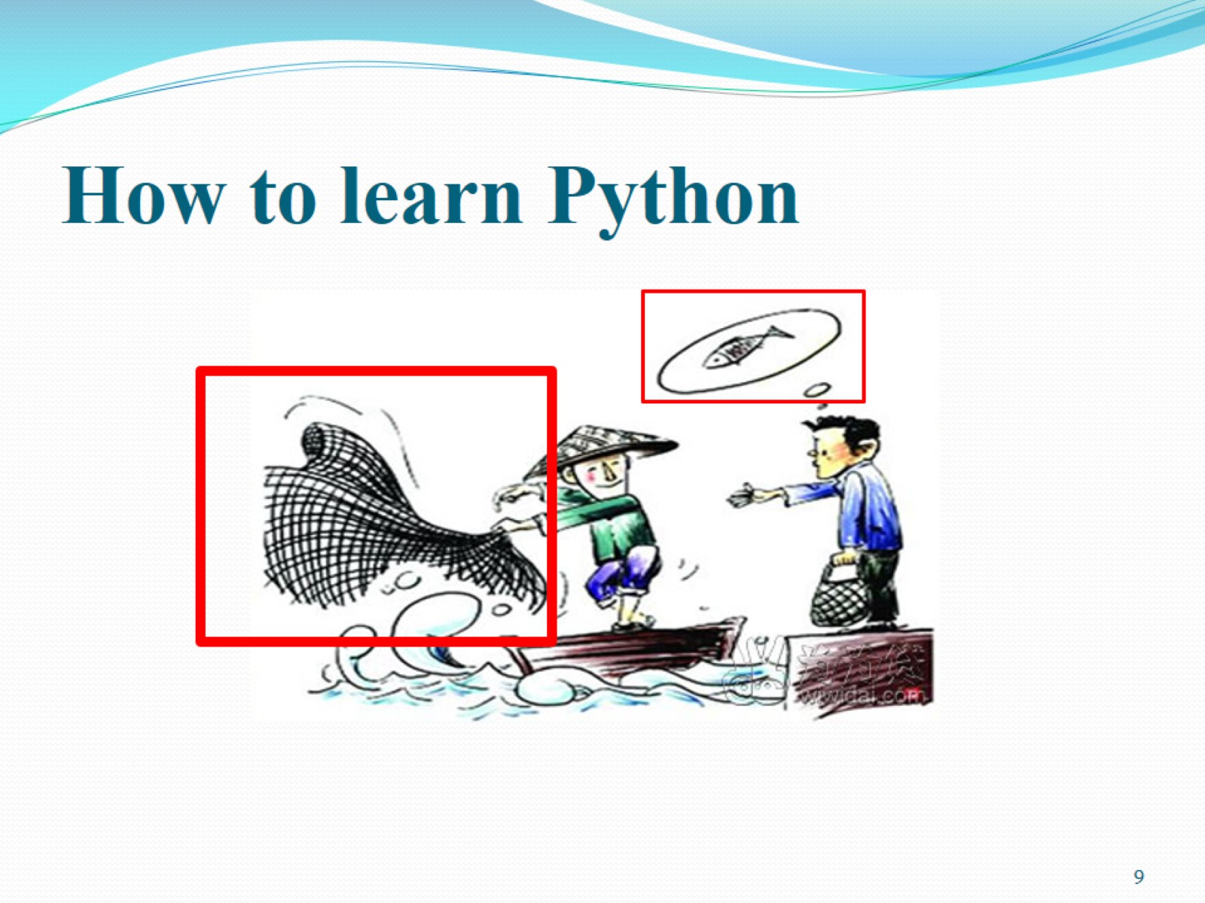
How to learn Python

Slide 10
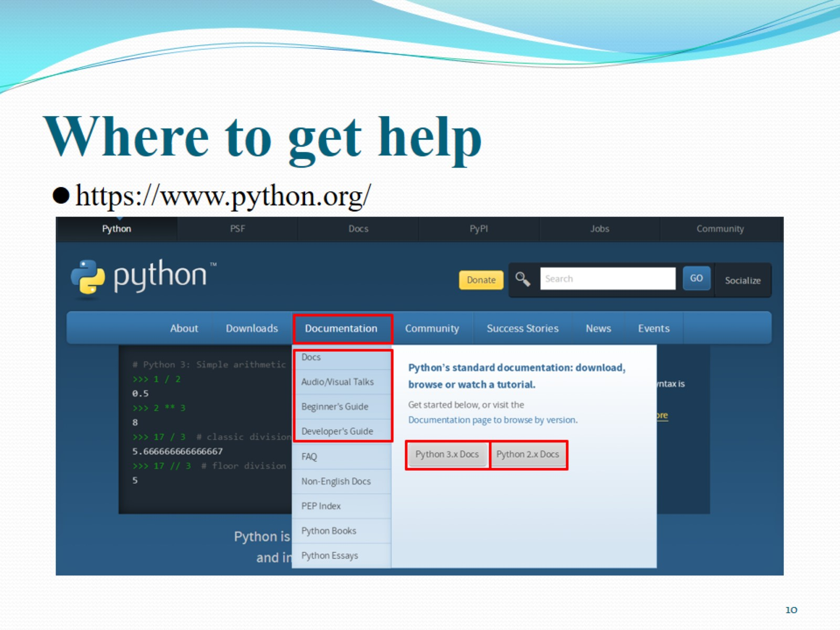
Where to get help

Slide 11
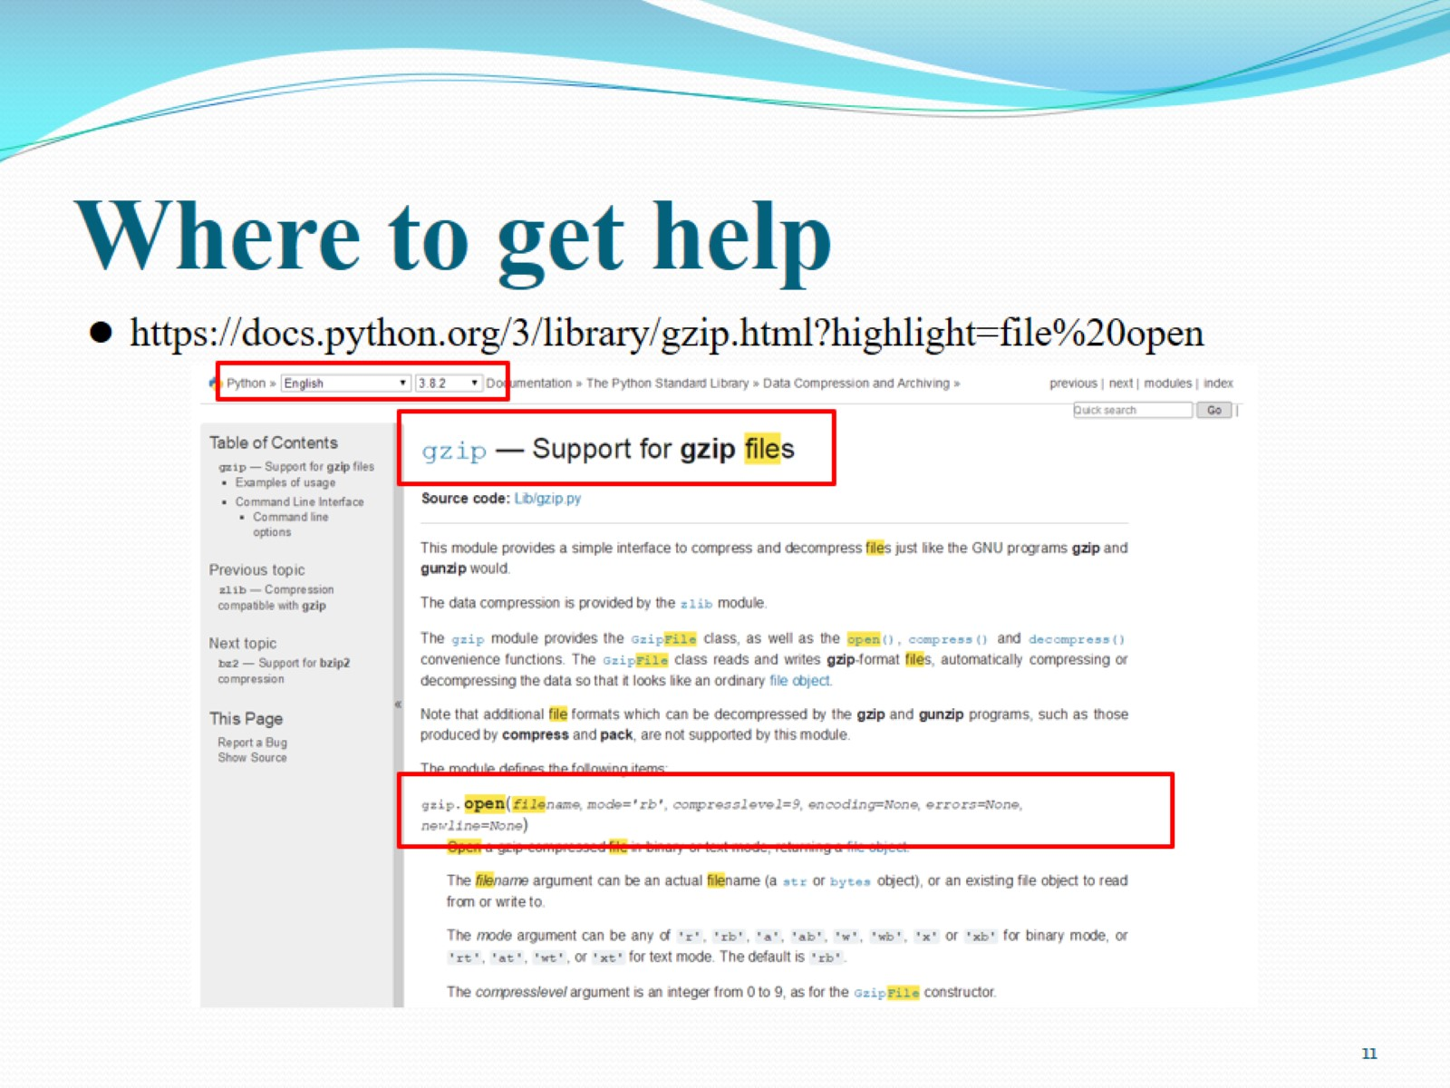
Where to get help

Slide 12
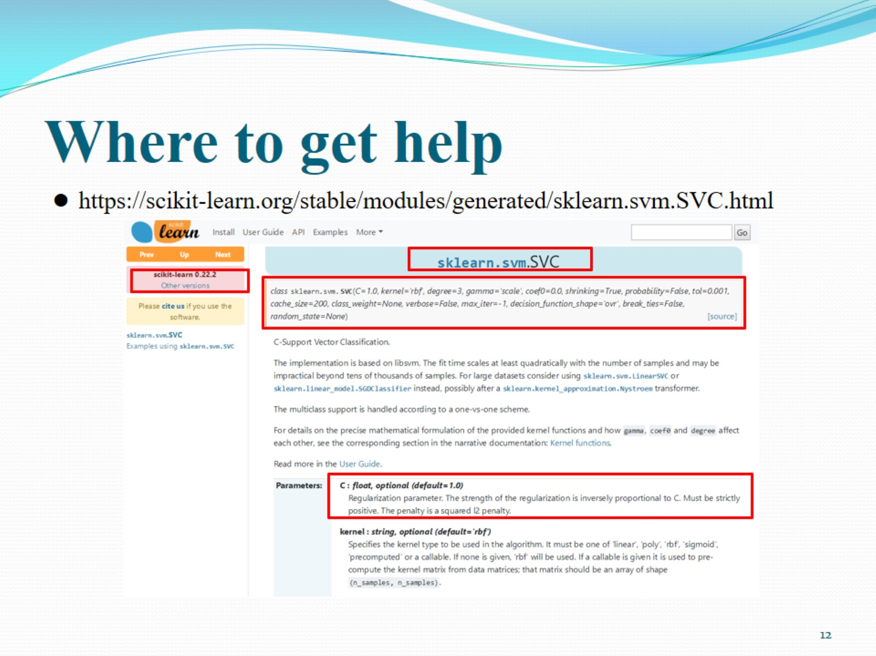
Where to get help

Slide 13
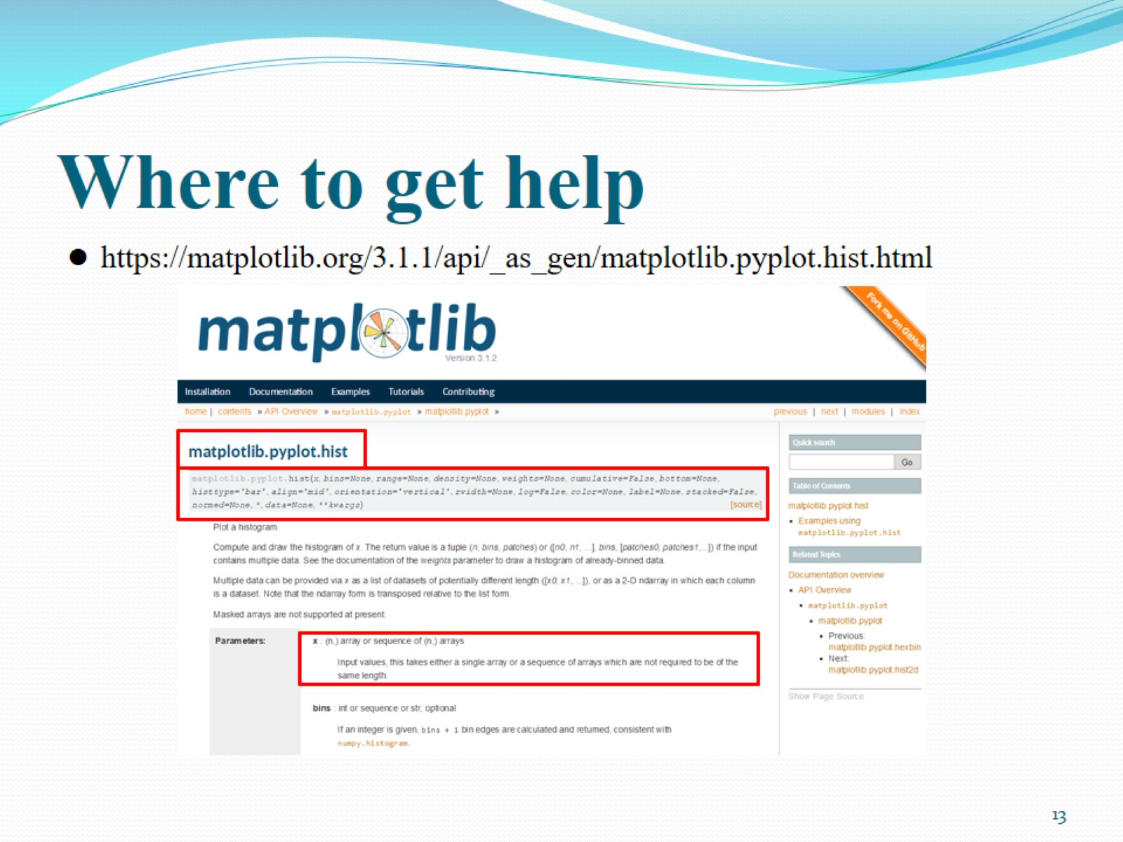
Where to get help

Slide 14
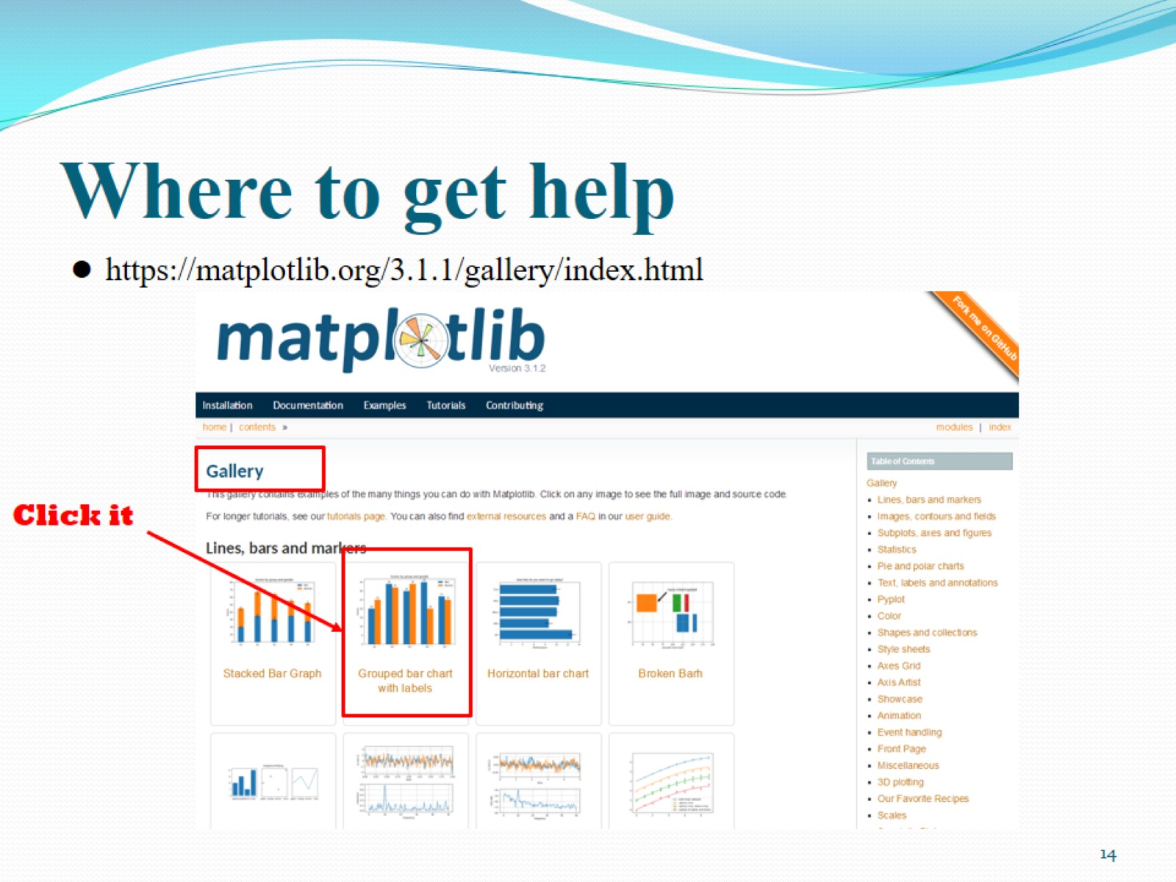
Where to get help

Slide 15
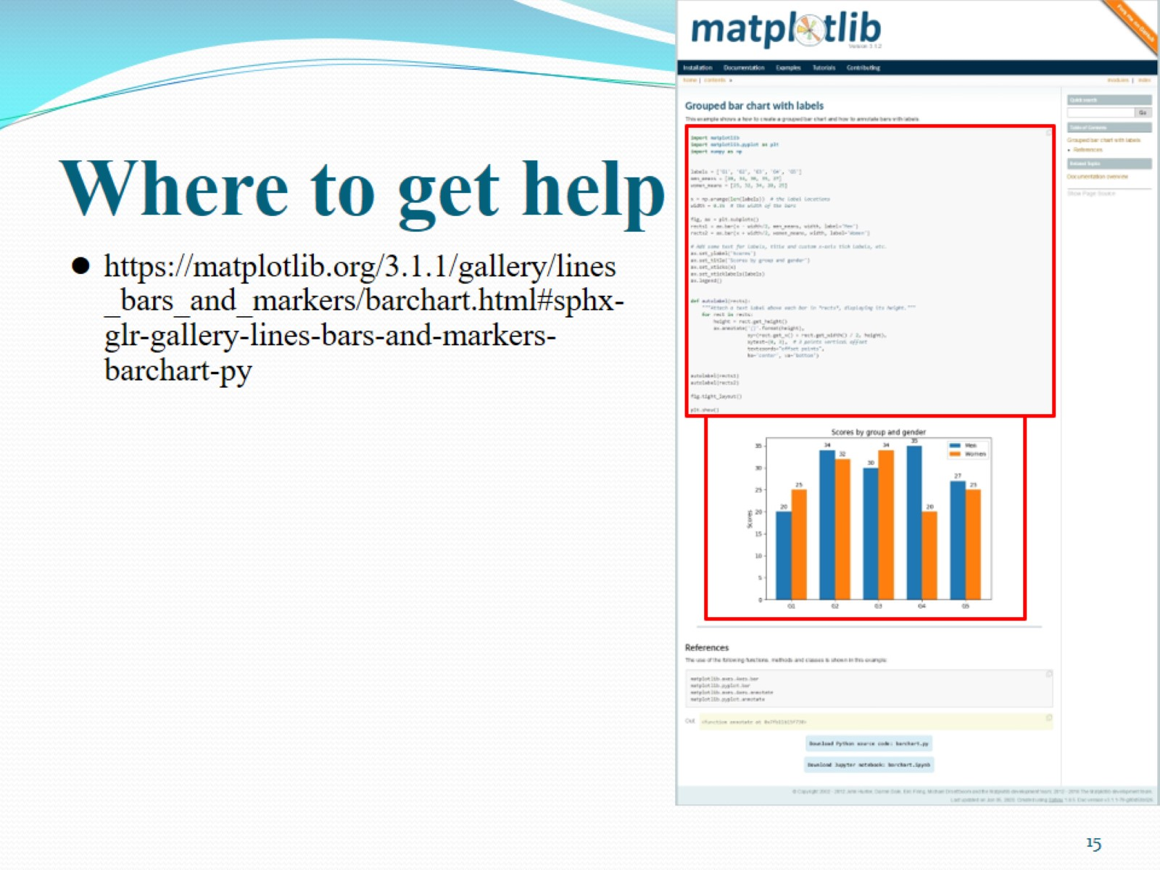
Where to get help

Slide 16
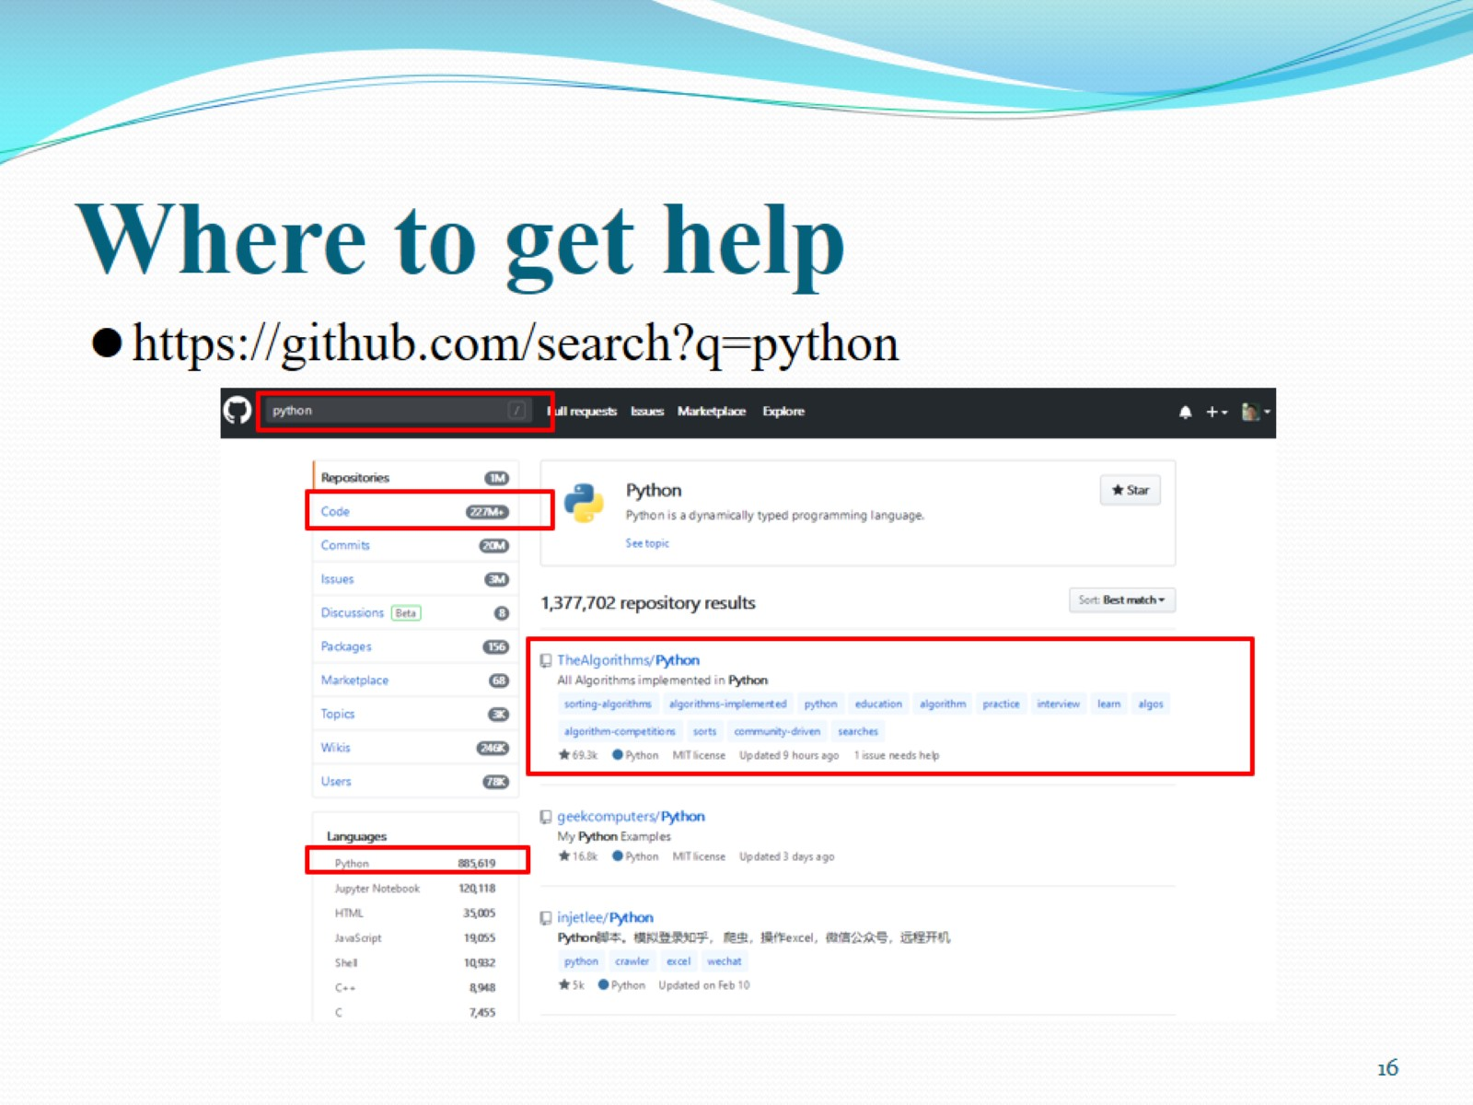
Where to get help

Slide 17
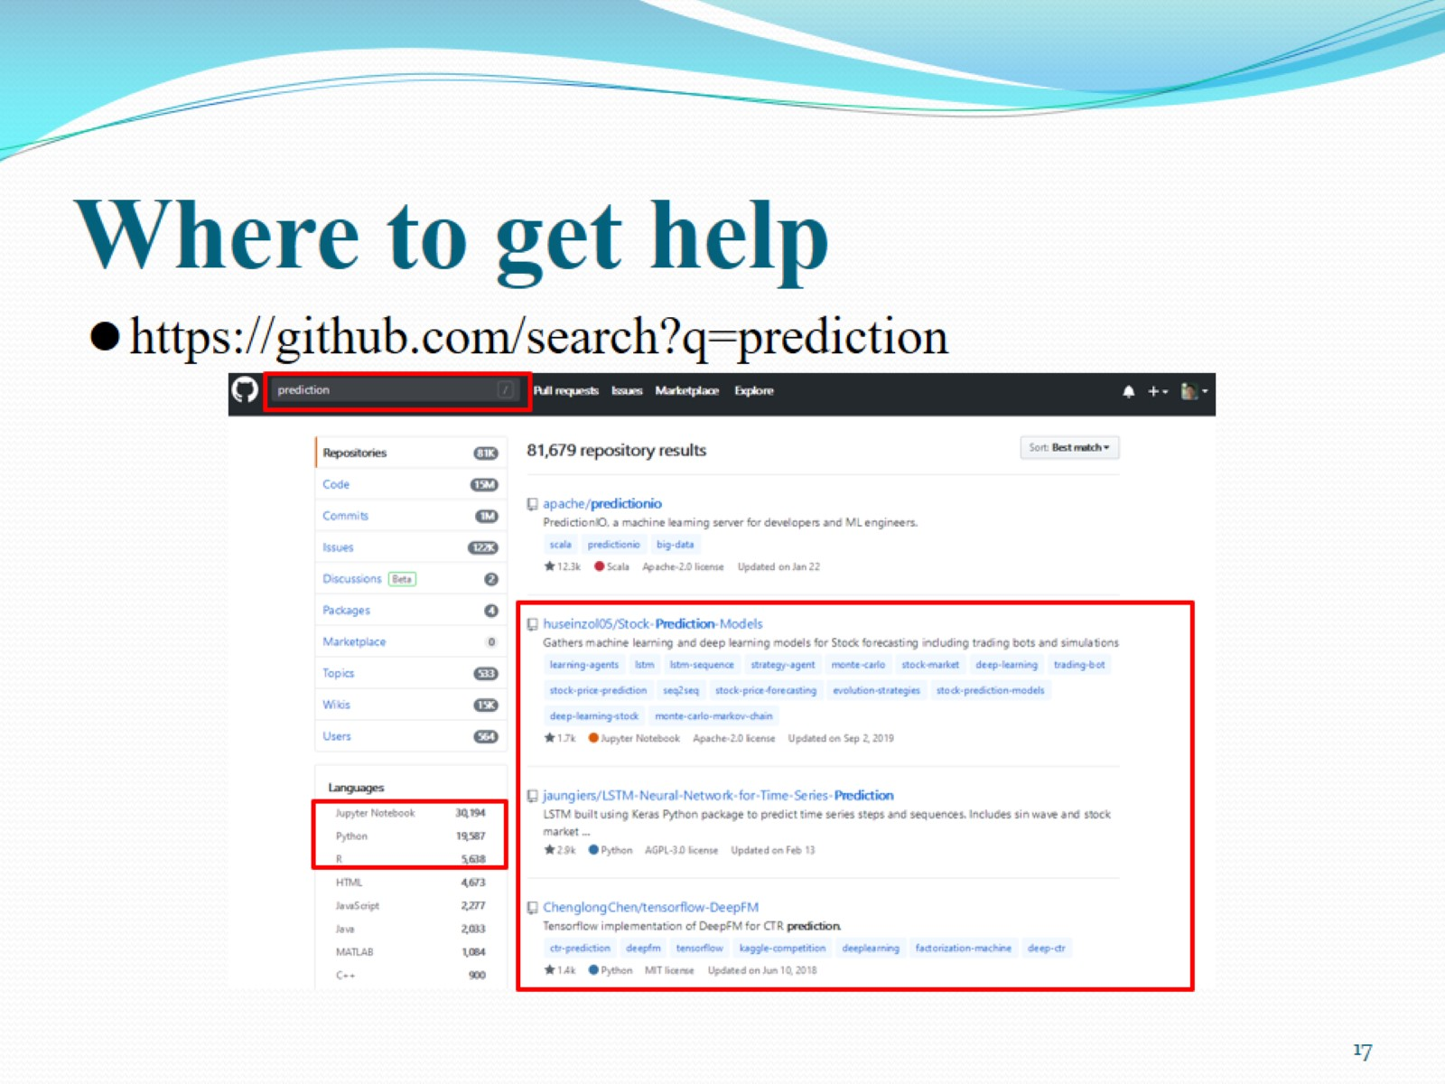
Where to get help

Slide 18
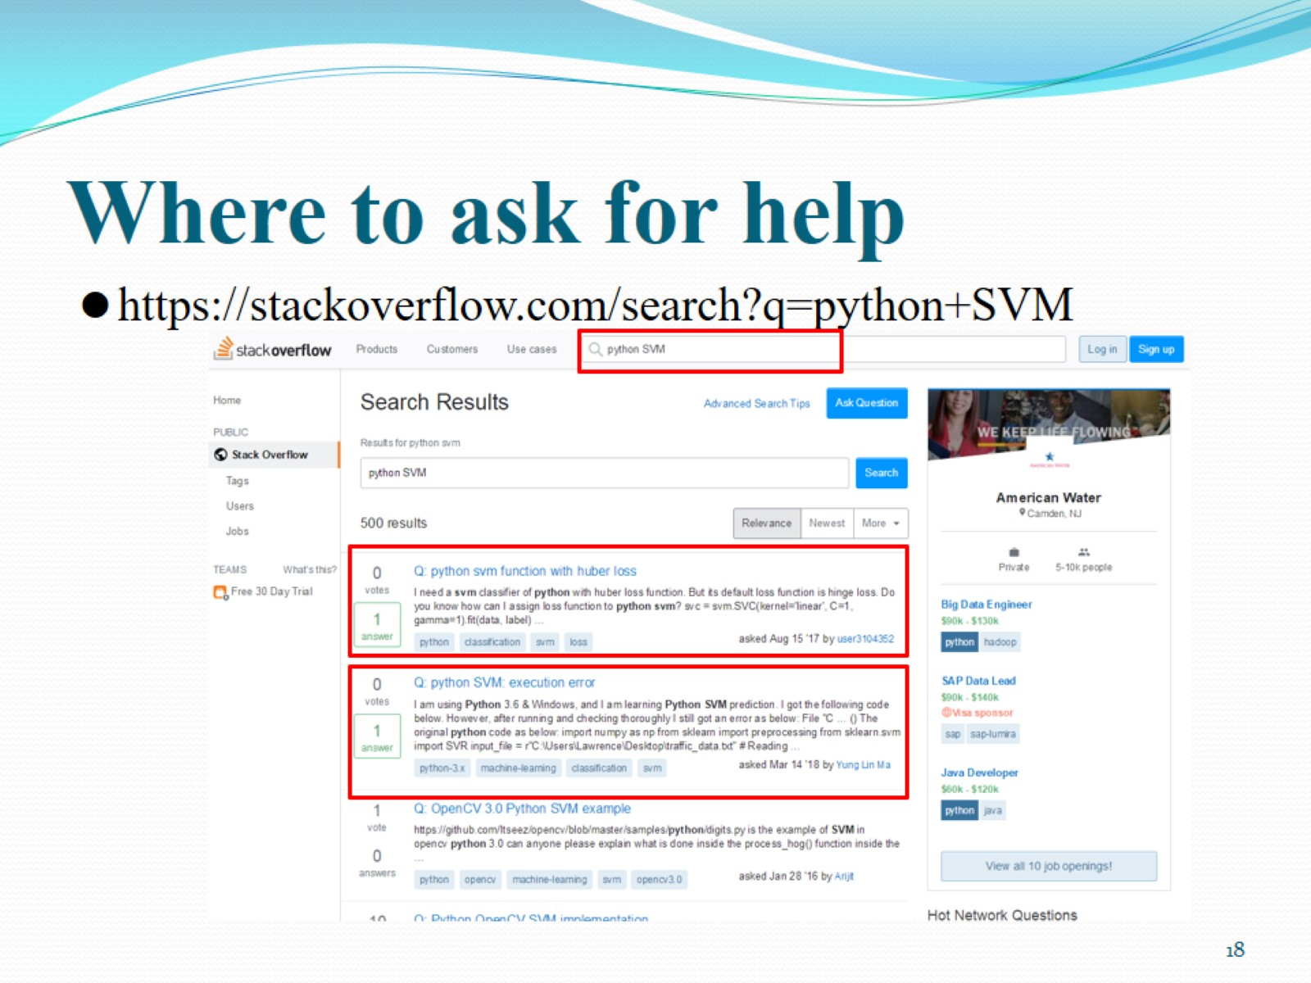
Where to ask for help

Slide 19
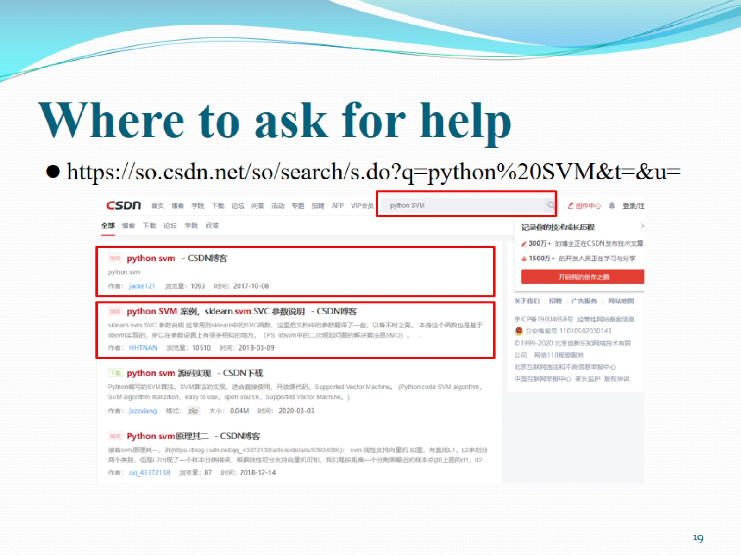
Where to ask for help

Slide 20

Outline

Slide 21
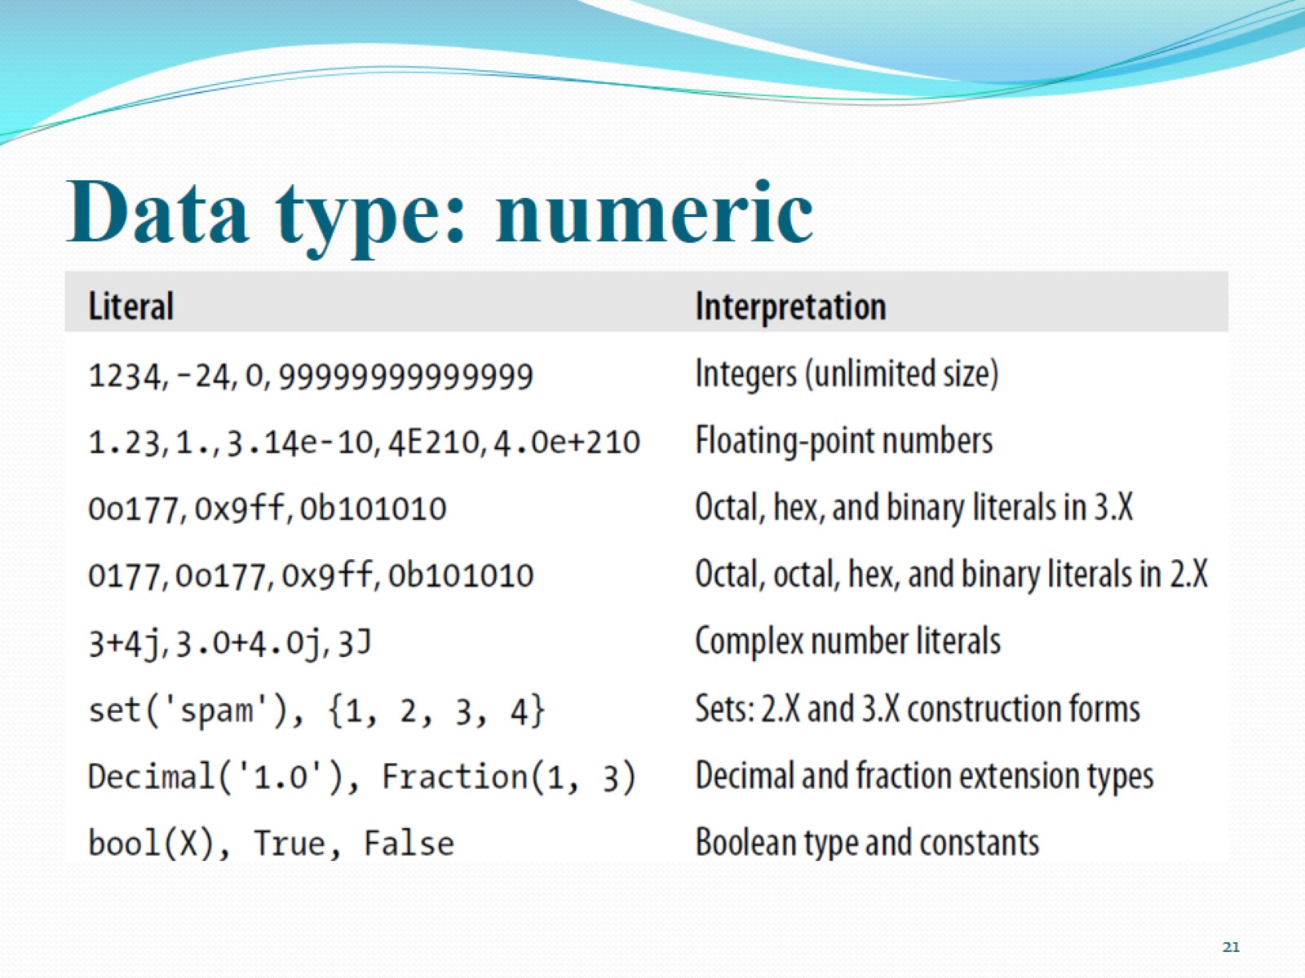
Data type: numeric

Slide 22
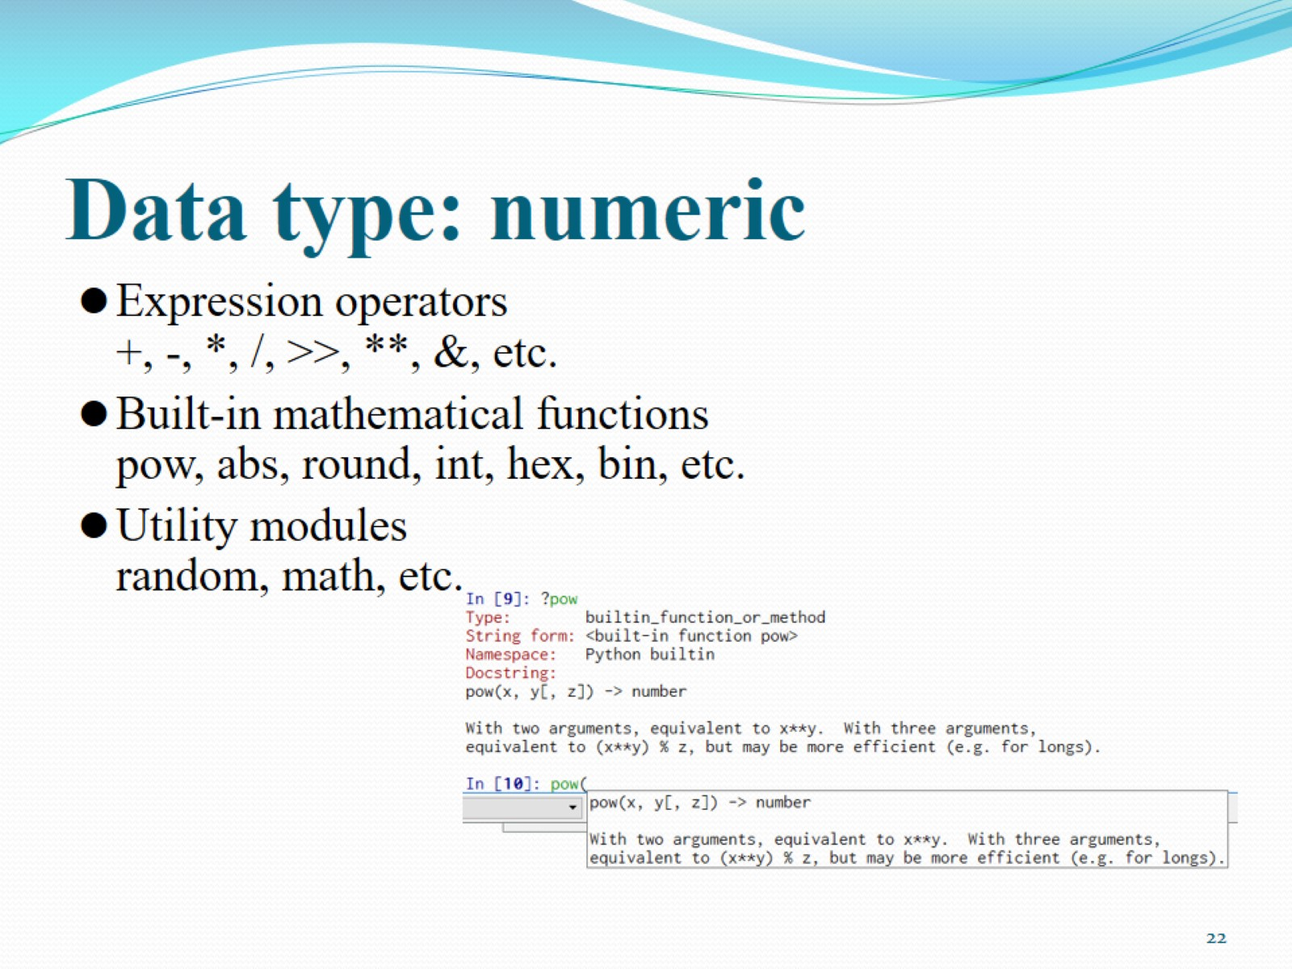
Data type: numeric

Slide 23
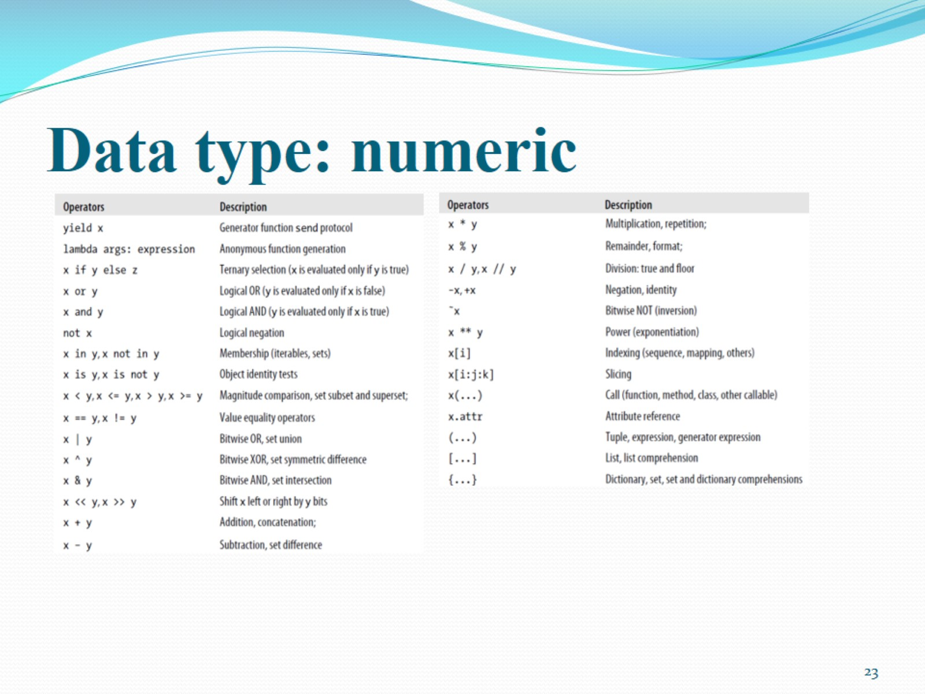
Data type: numeric

Slide 24
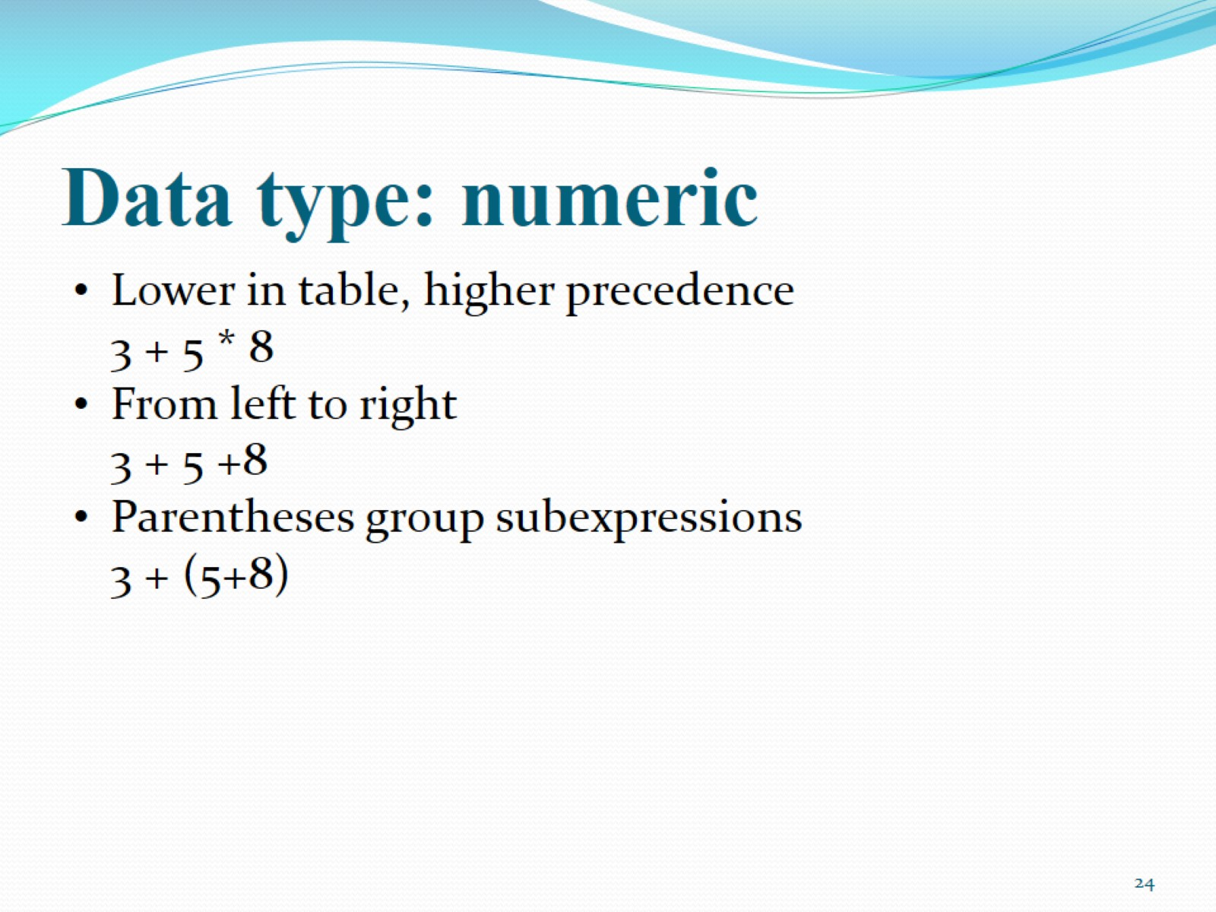
Data type: numeric

Slide 25
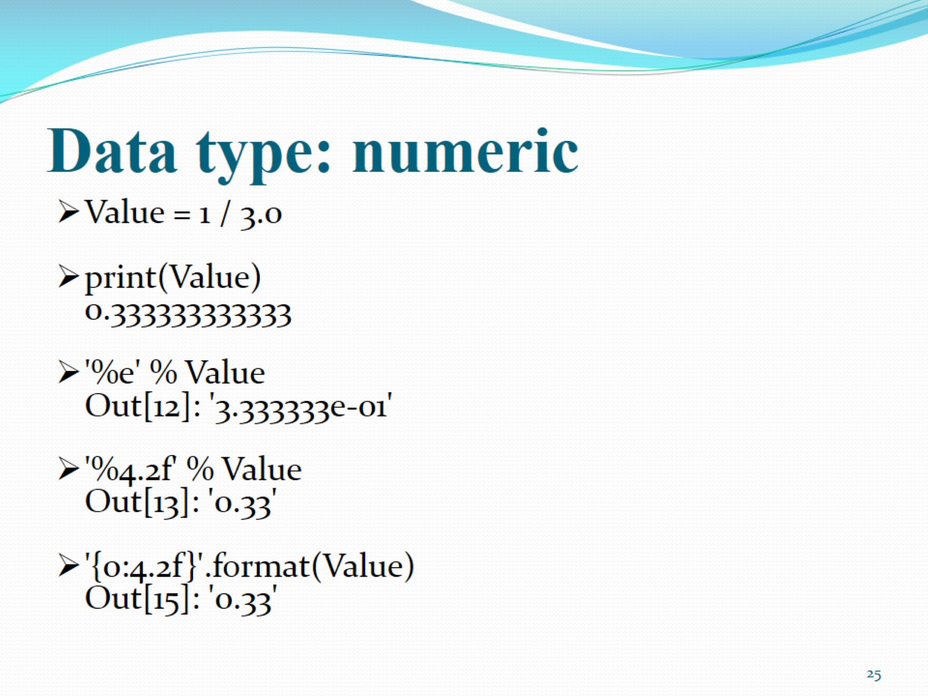
Data type: numeric

Slide 26
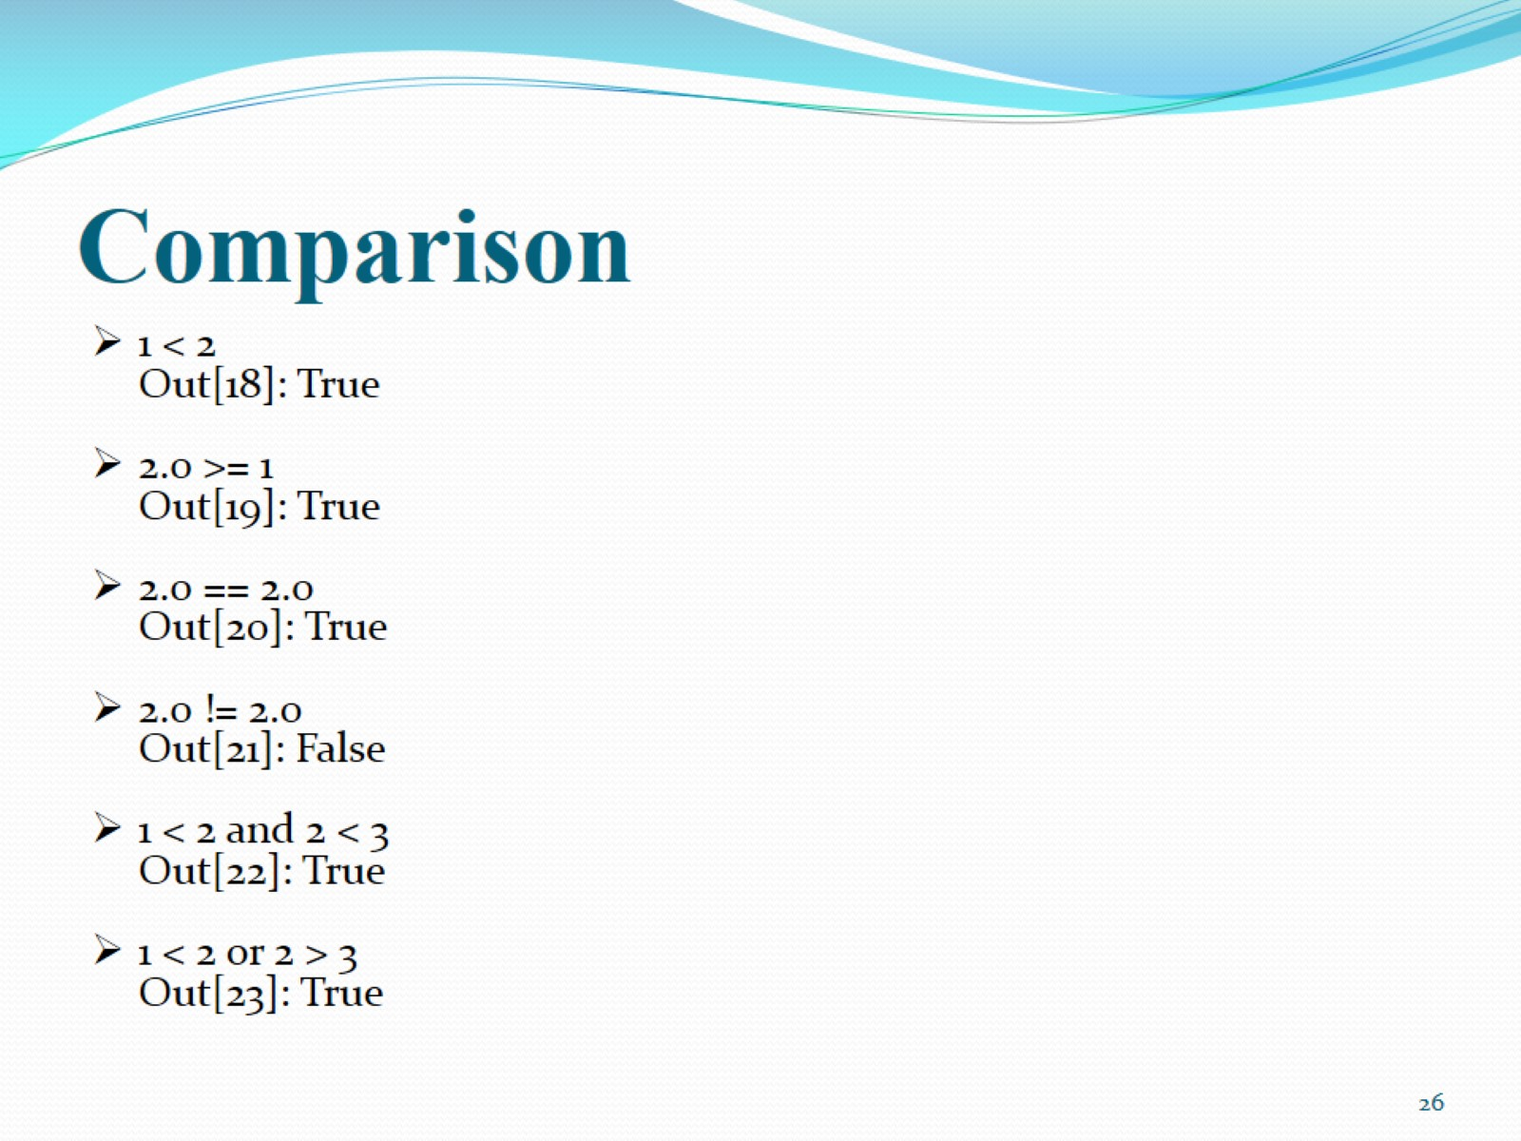
Comparison

Slide 27
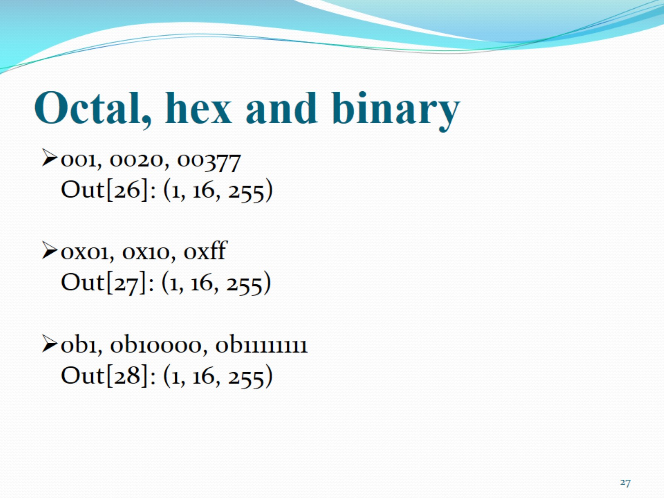
Octal, hex and binary

Slide 28
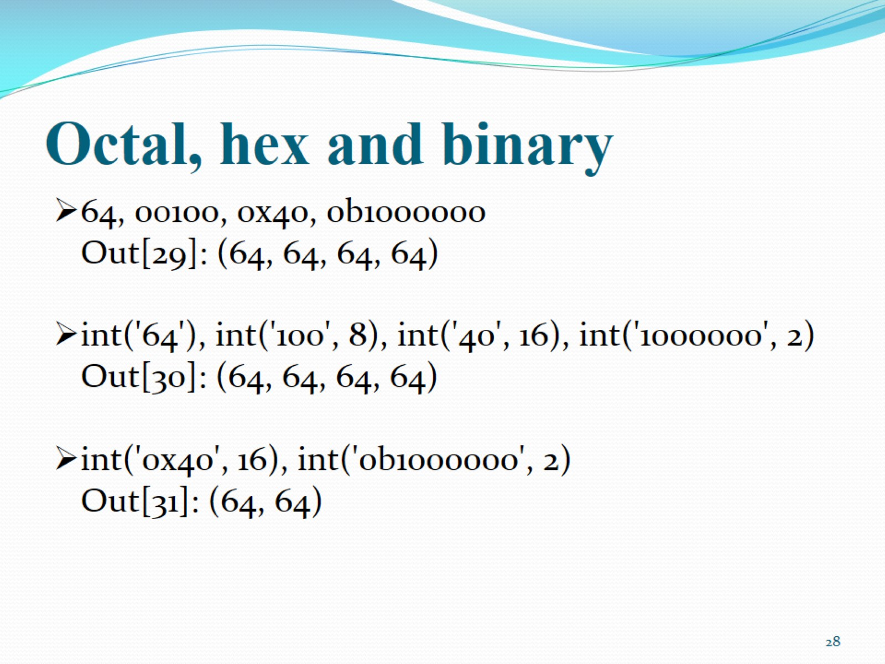
Octal, hex and binary

Slide 29
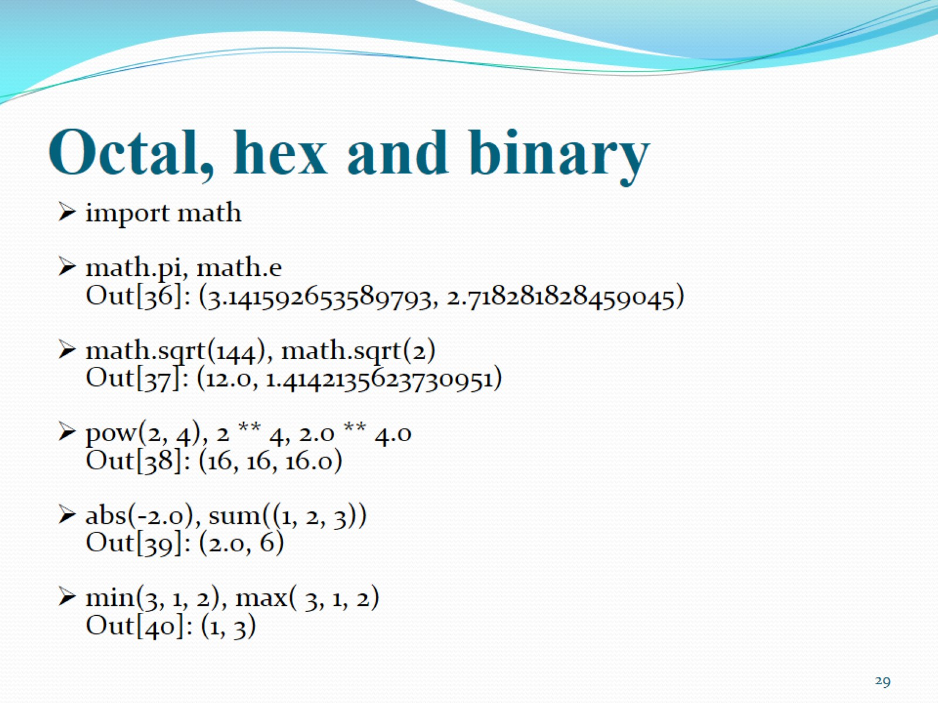
Octal, hex and binary

Slide 30
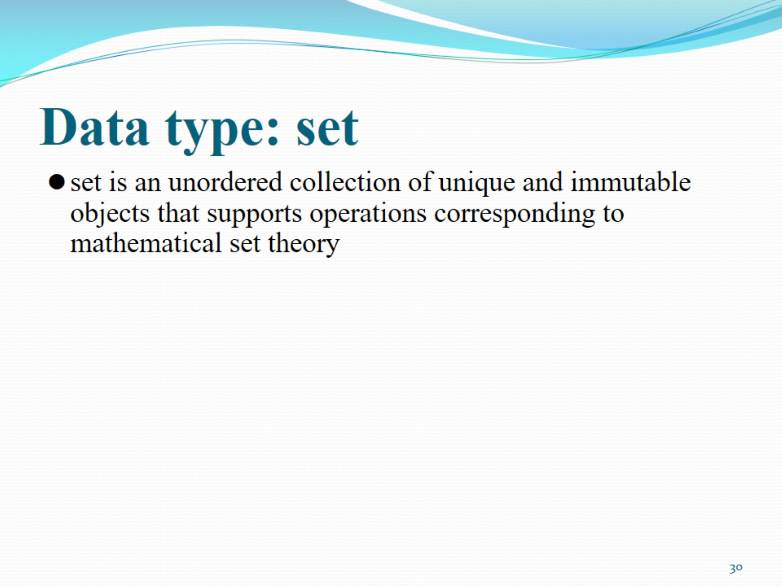
Data type: set

Slide 31
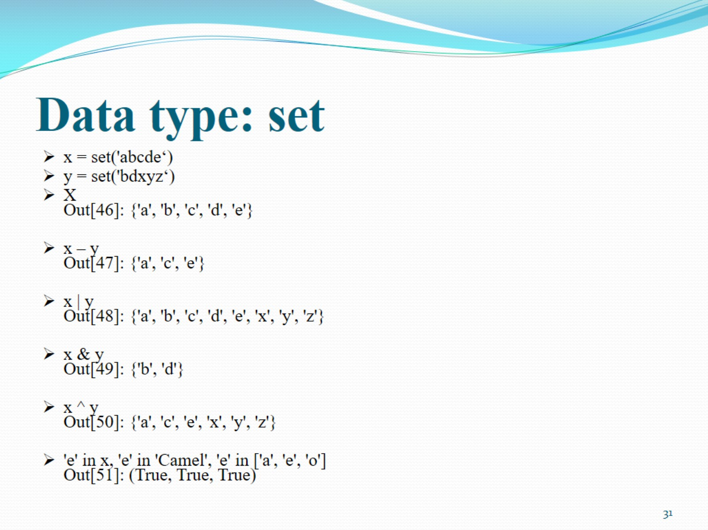
Data type: set

Slide 32
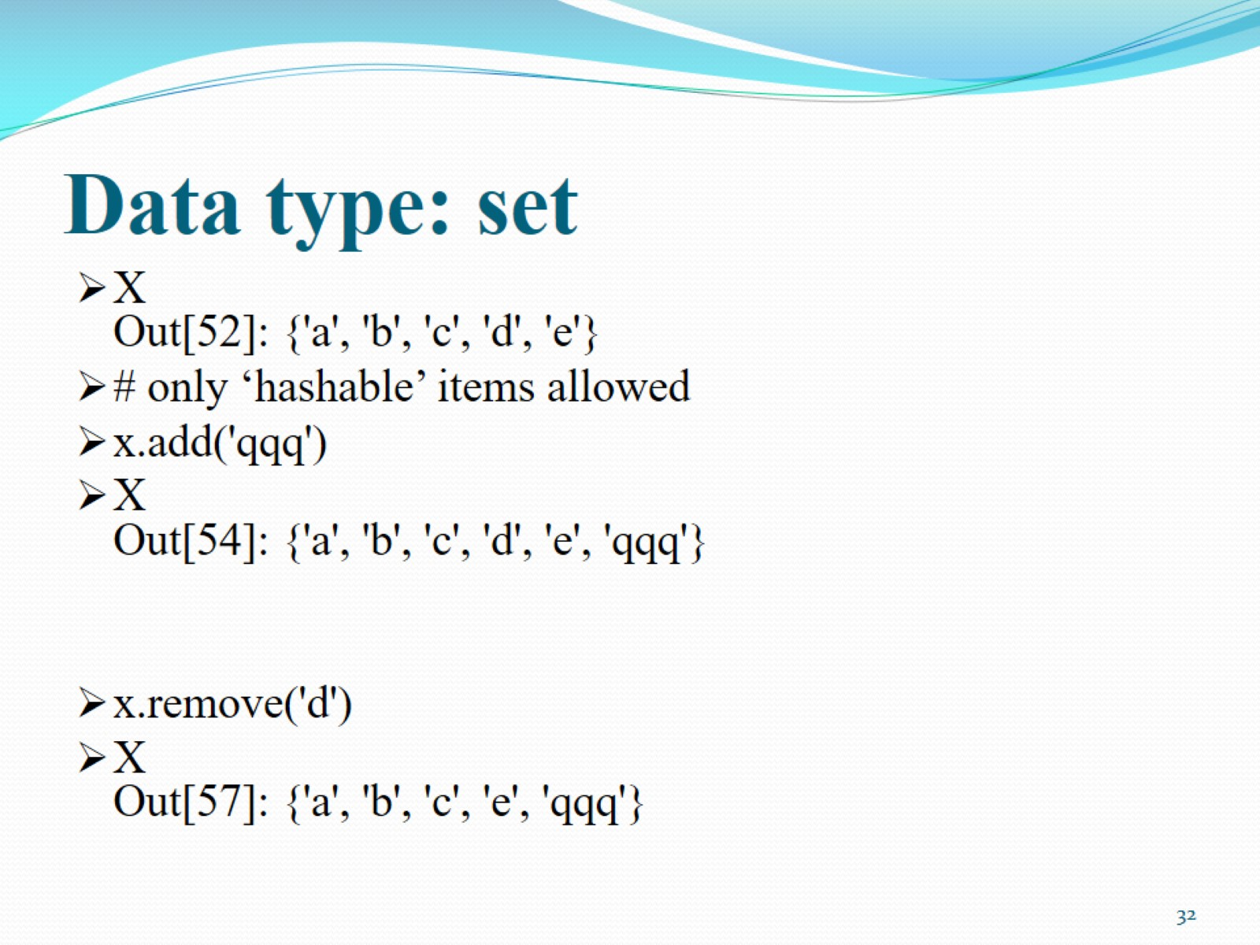
Data type: set

Slide 33
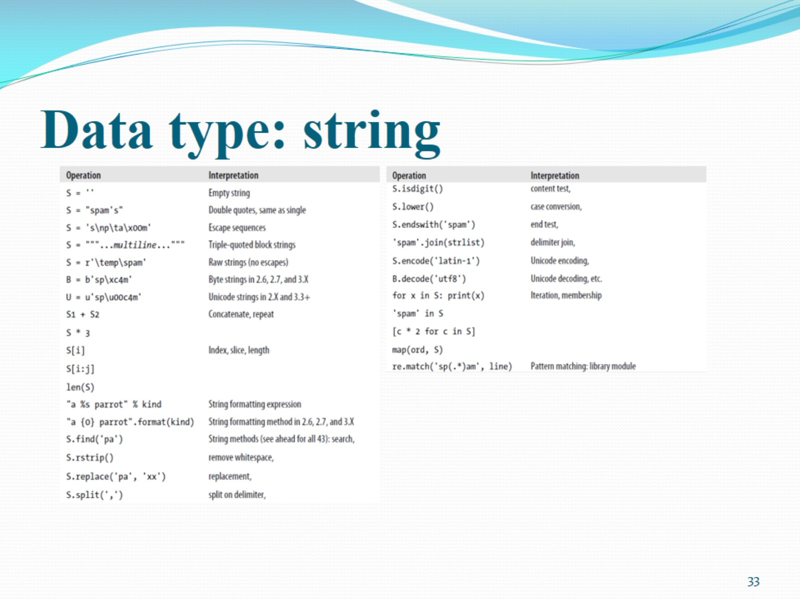
Data type: string

Slide 34
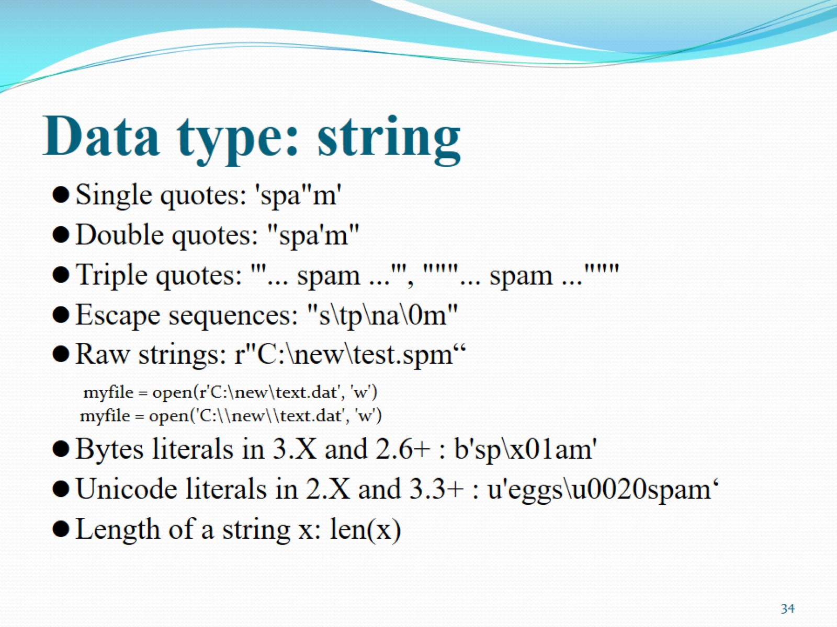
Data type: string

Slide 35
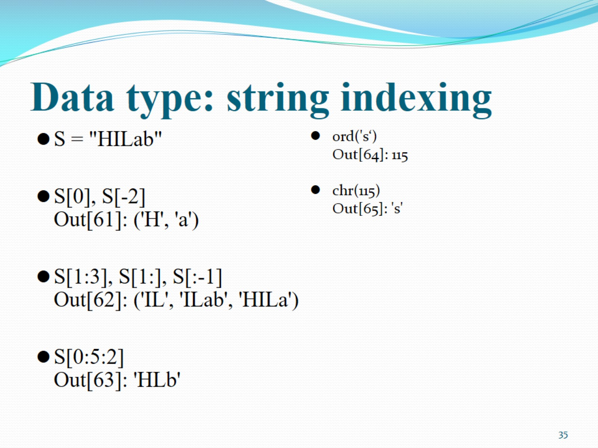
Data type: string indexing

Slide 36
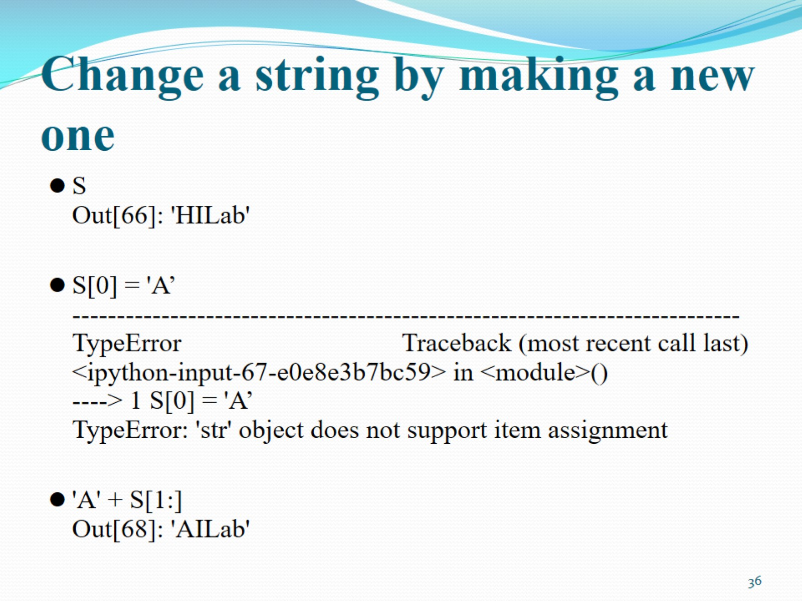
Change a string by making a new one

Slide 37
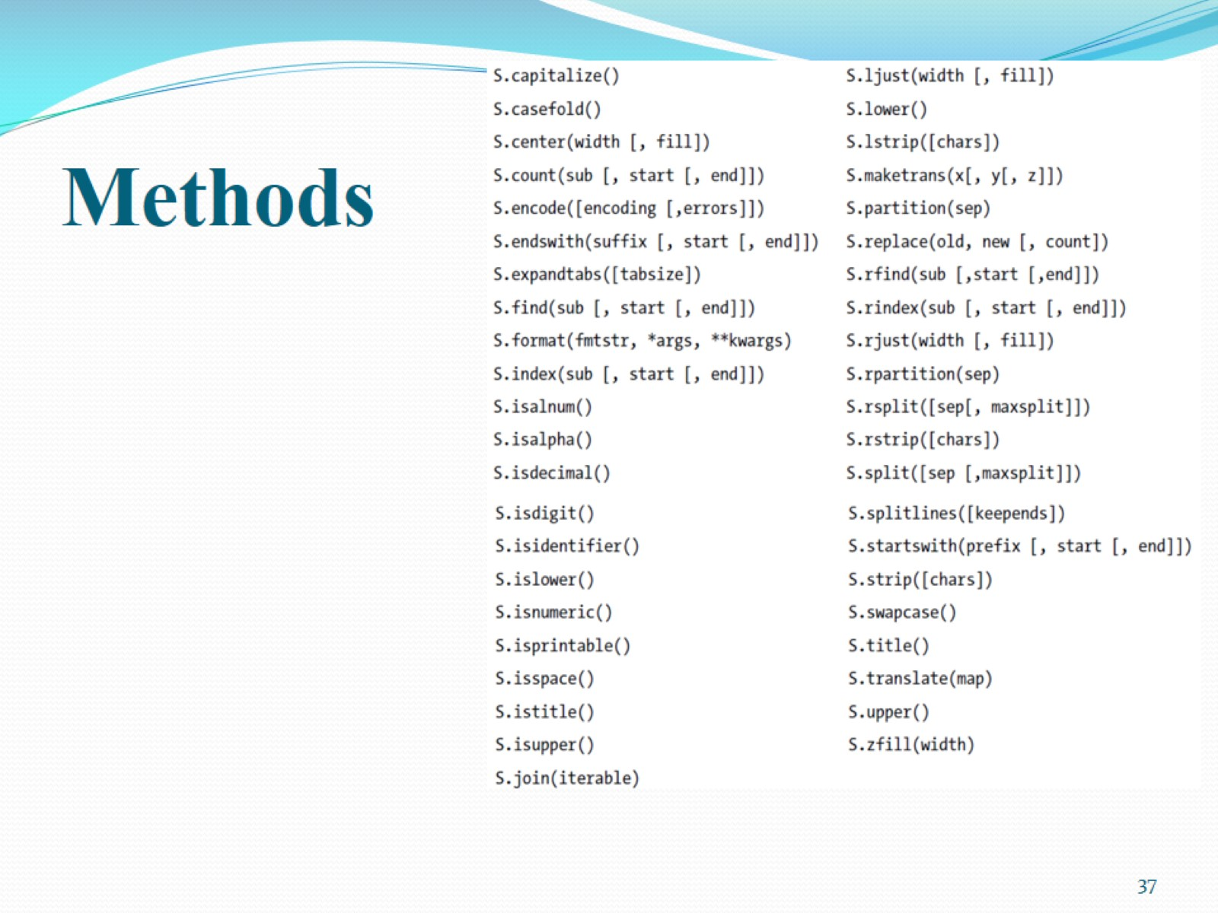
Methods

Slide 38
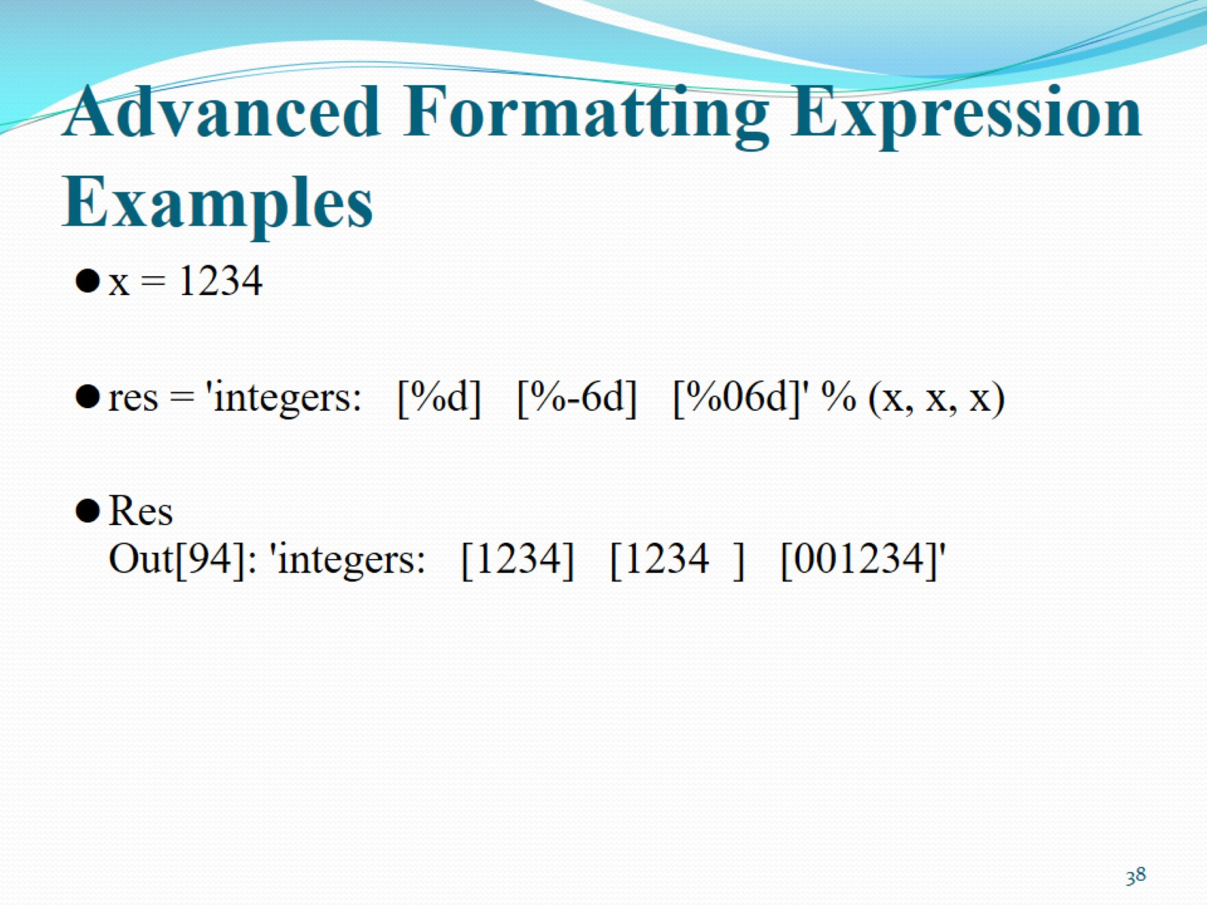
Advanced Formatting Expression Examples

Slide 39
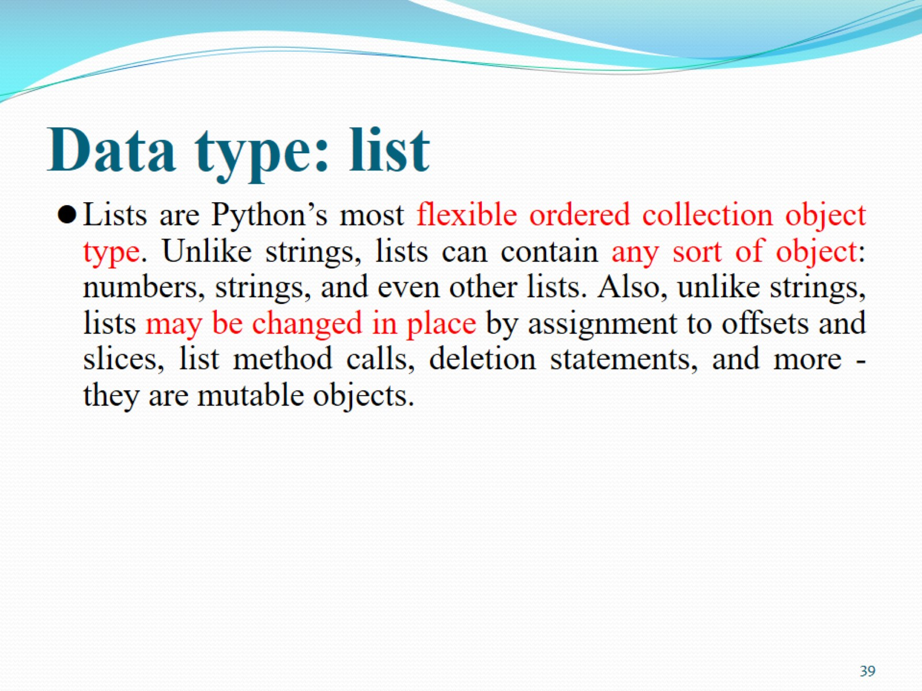
Data type: list

Slide 40
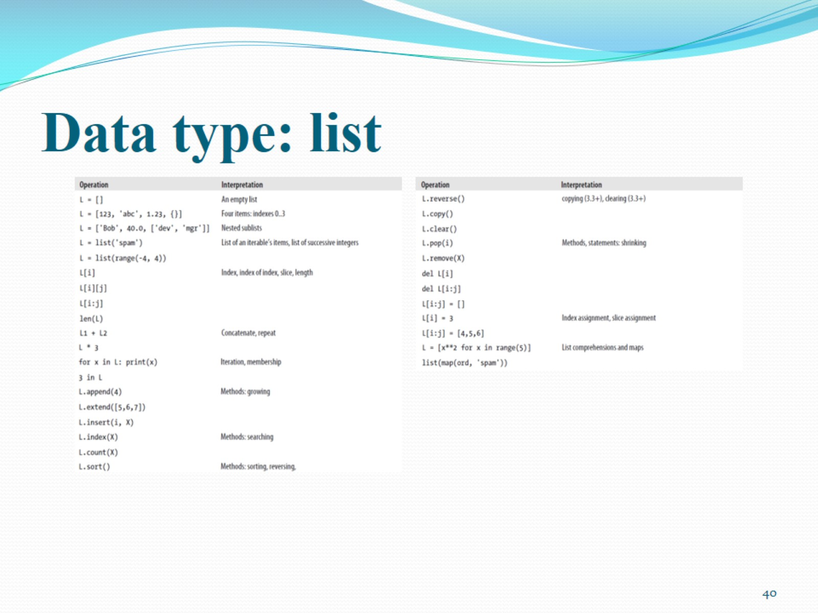
Data type: list

Slide 41
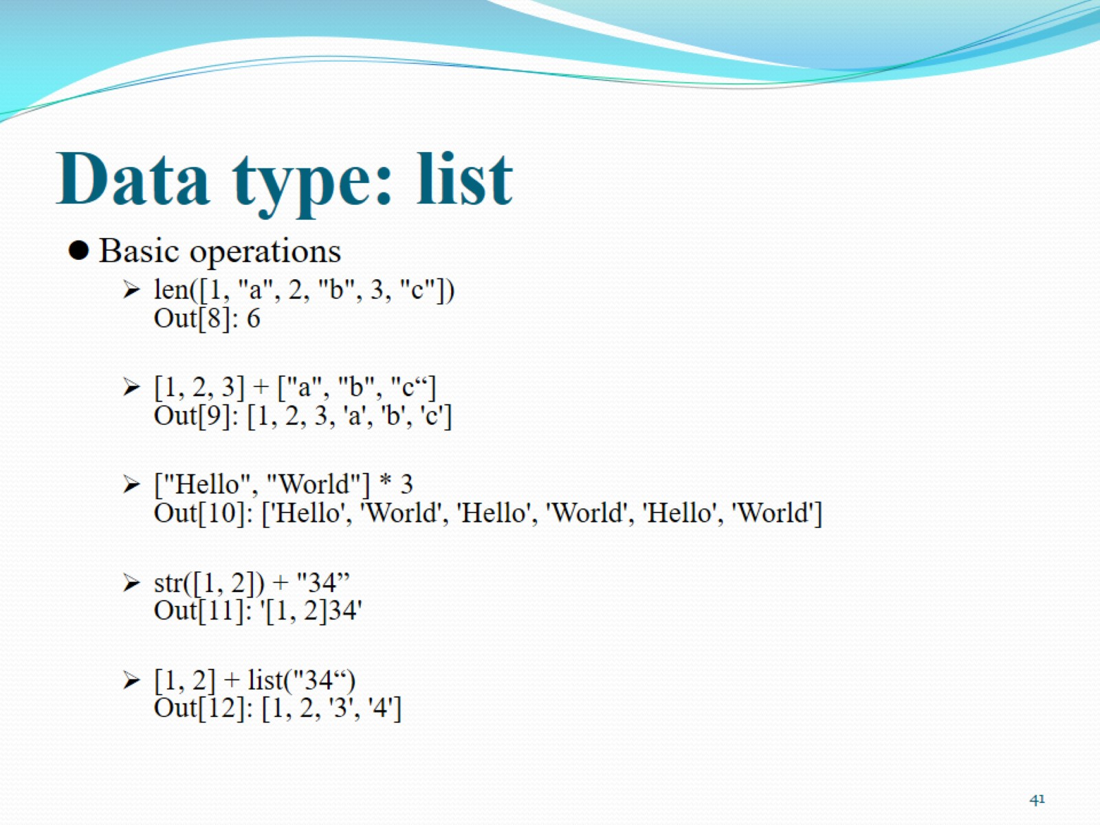
Data type: list

Slide 42
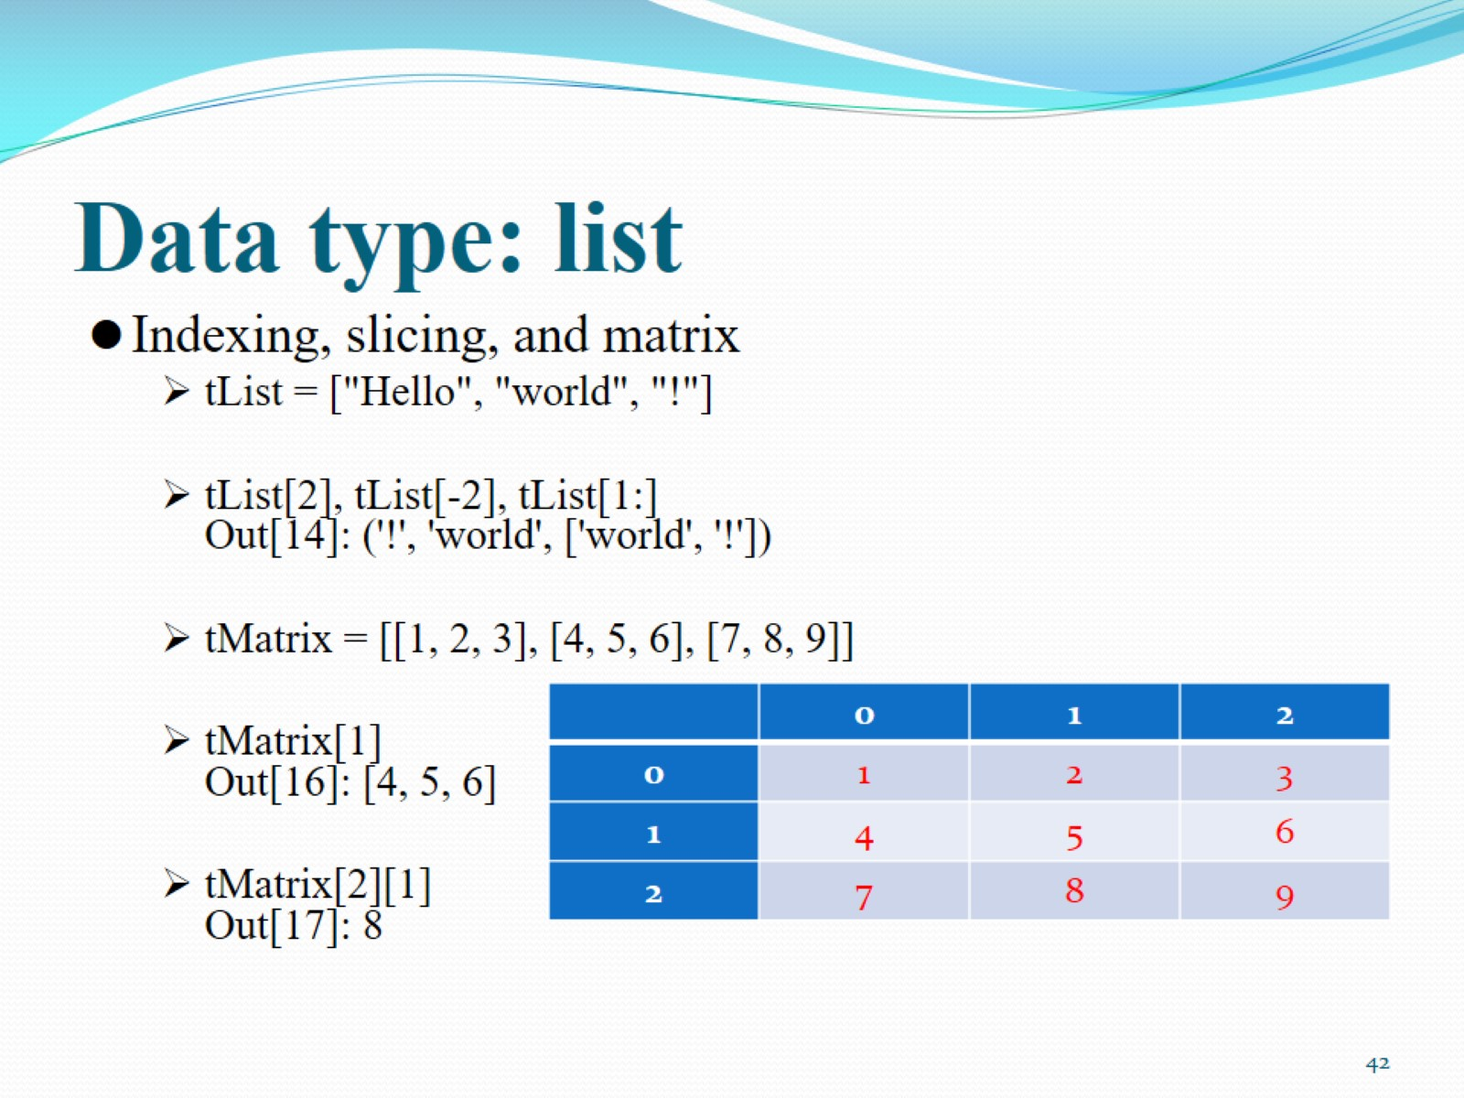
Data type: list

Slide 43
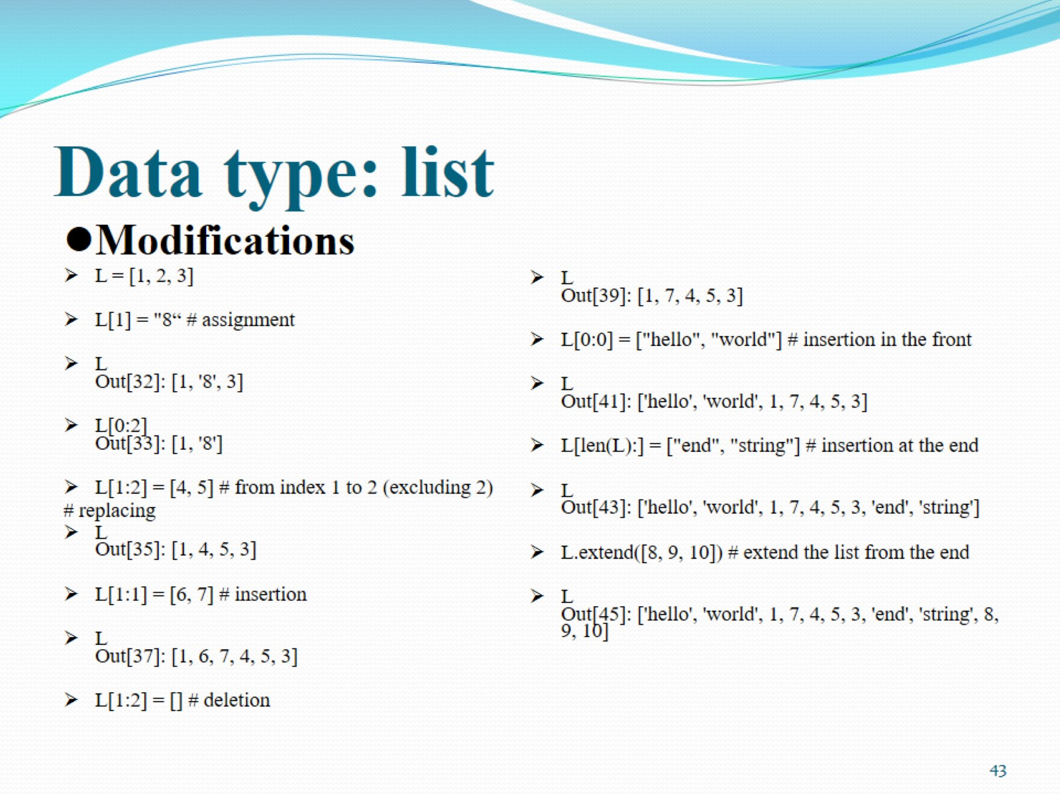
Data type: list

Slide 44
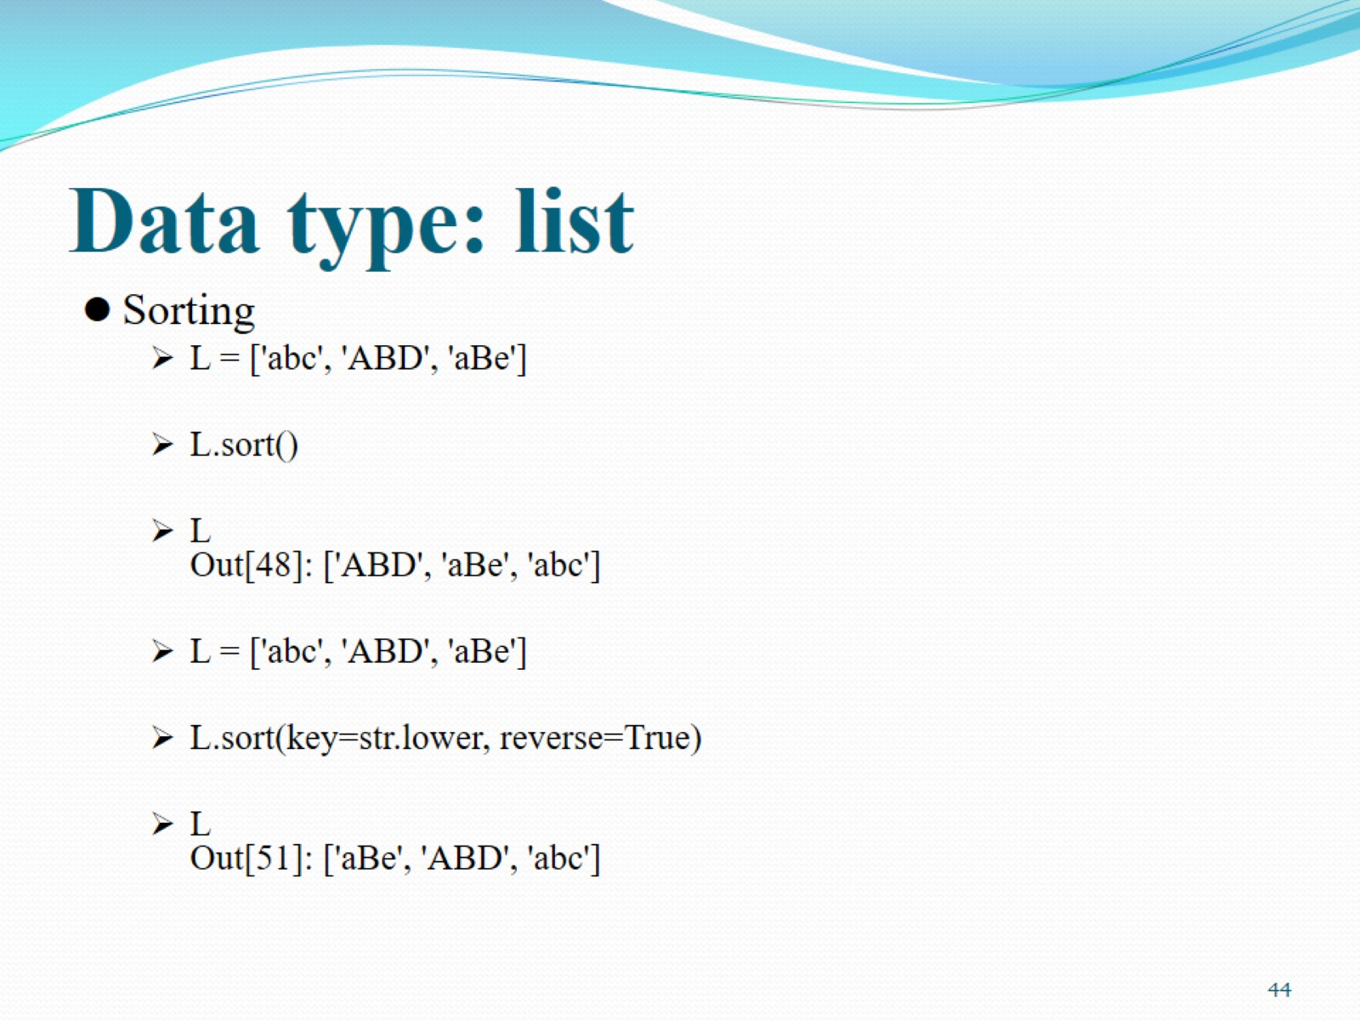
Data type: list

Slide 45
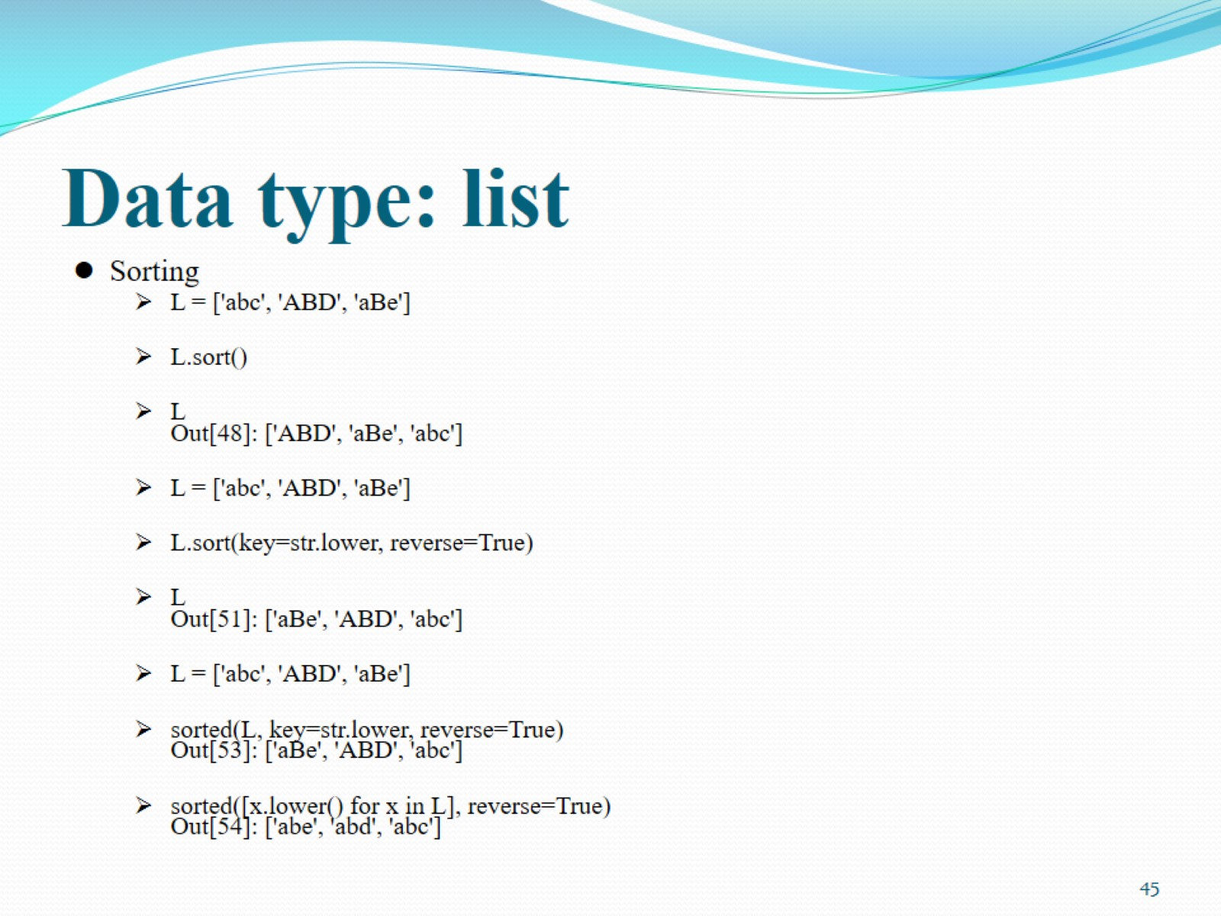
Data type: list

Slide 46
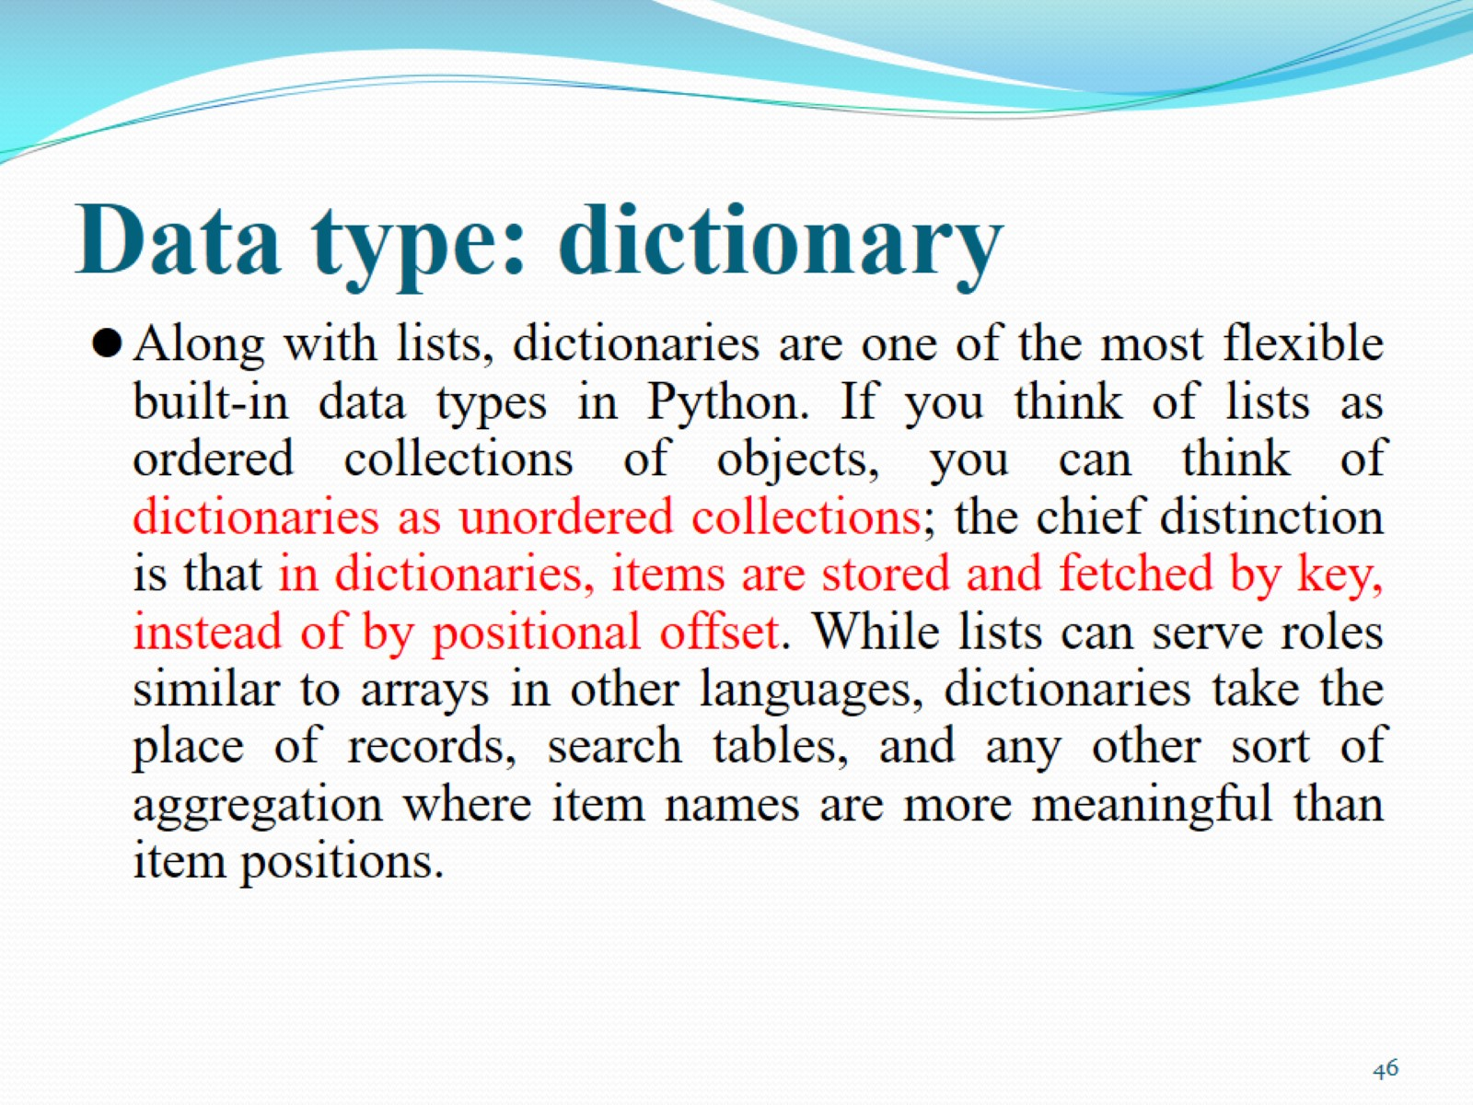
Data type: dictionary

Slide 47
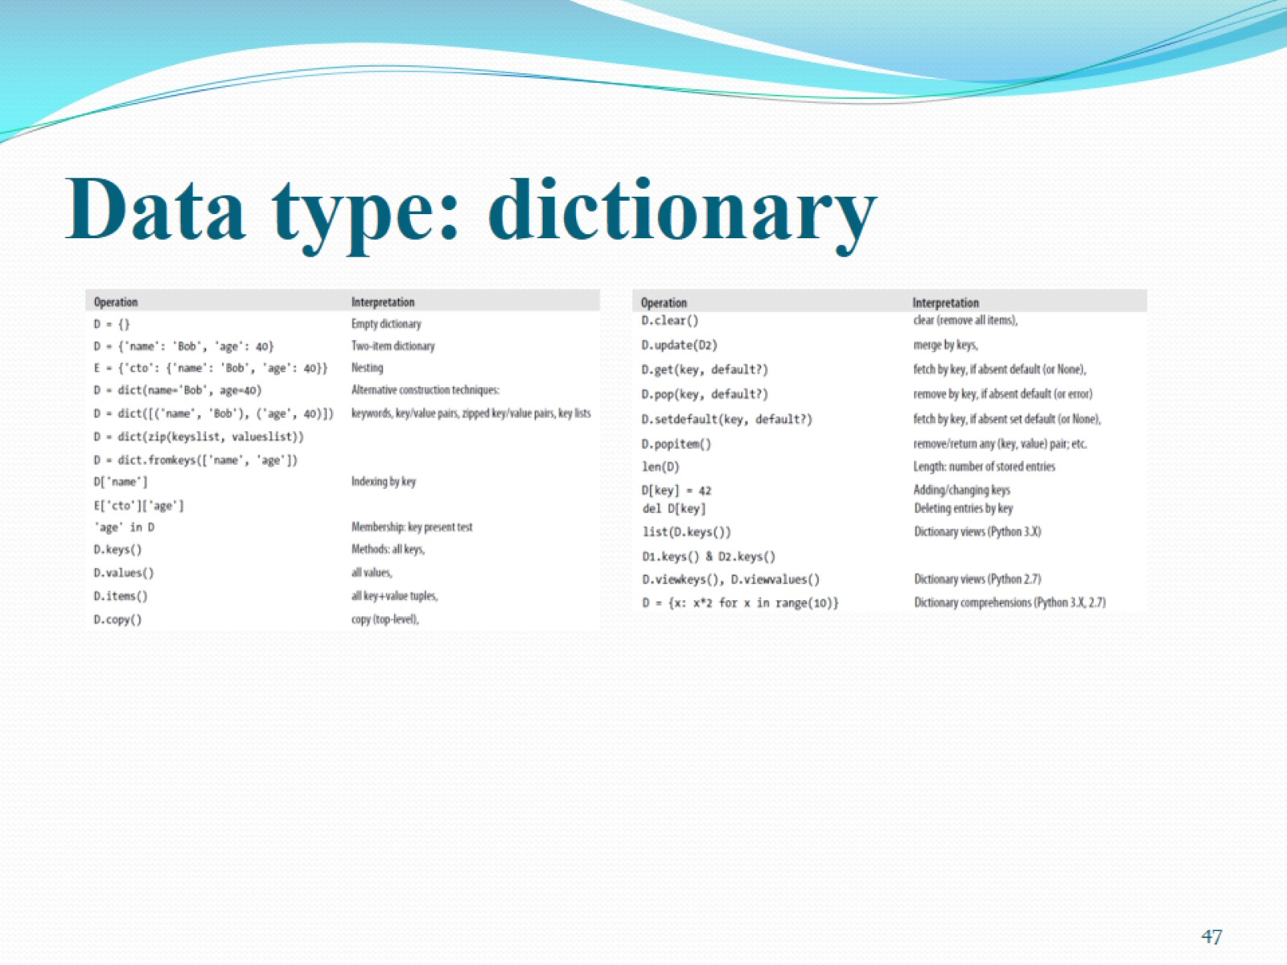
Data type: dictionary

Slide 48
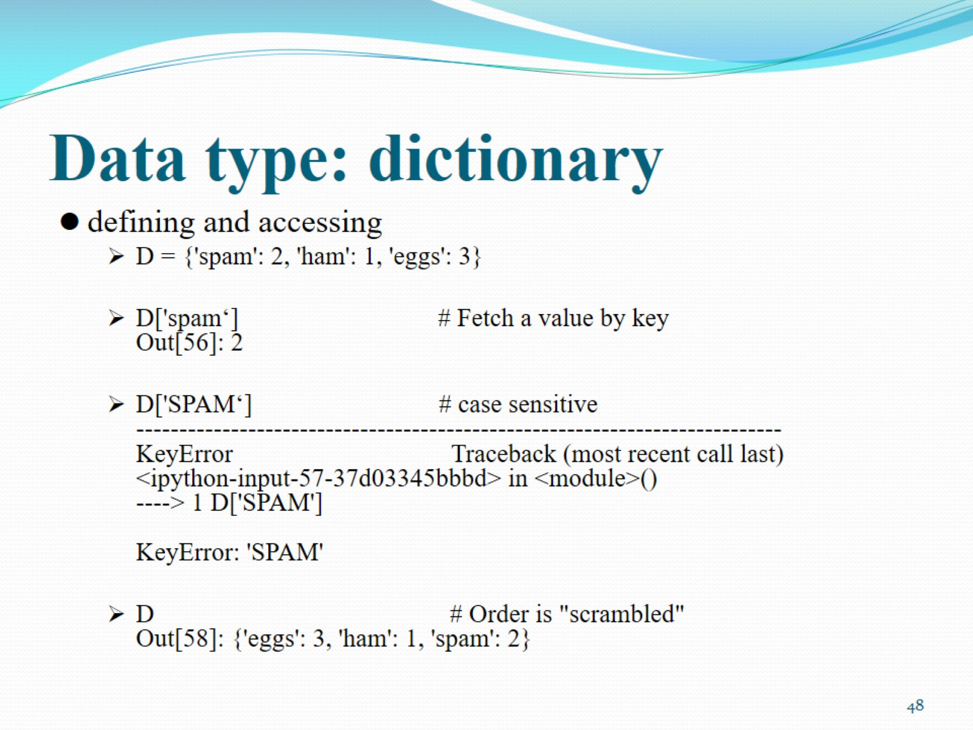
Data type: dictionary

Slide 49
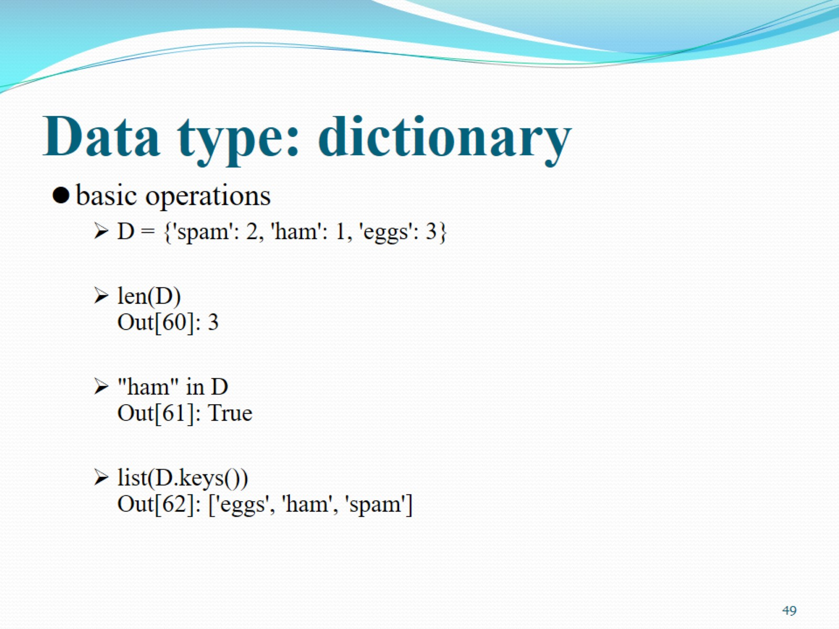
Data type: dictionary

Slide 50
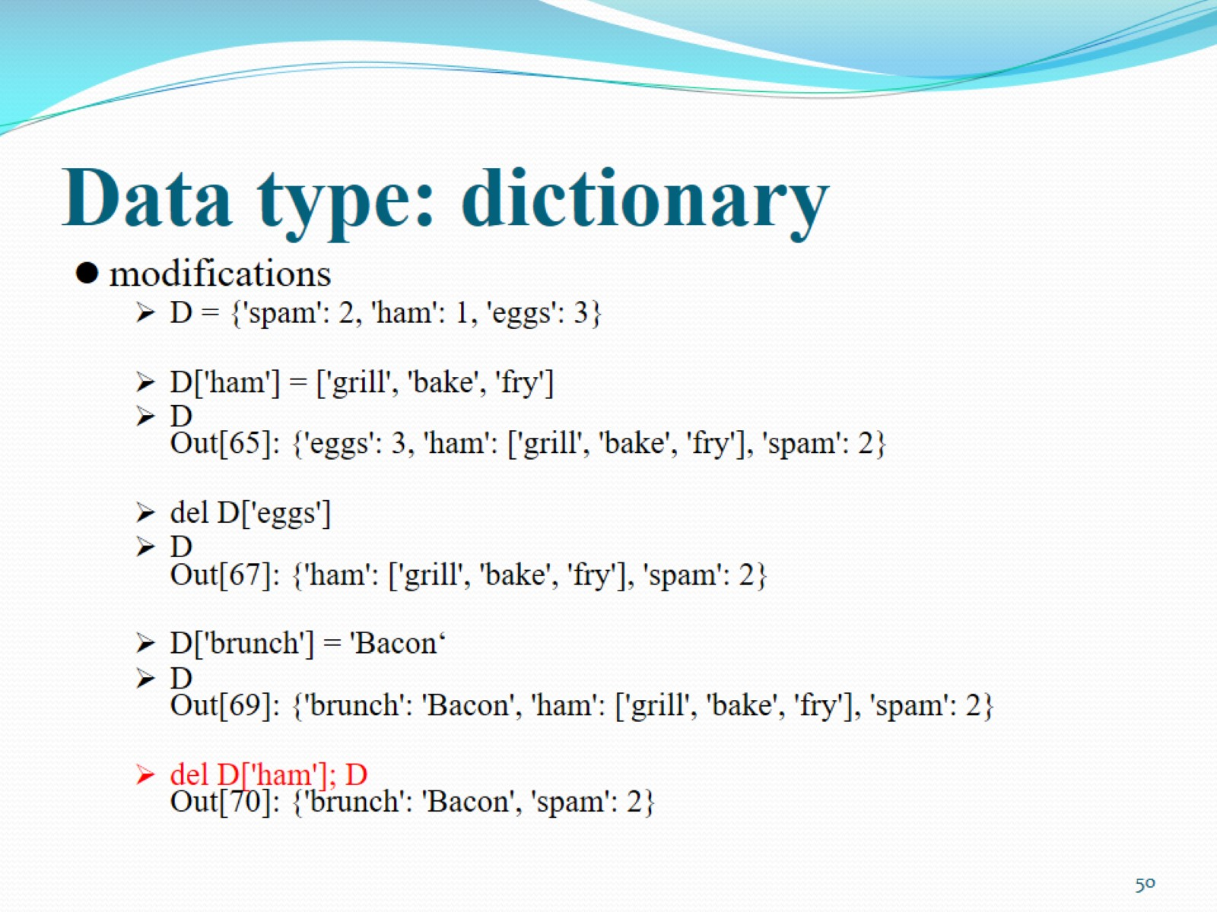
Data type: dictionary

Slide 51
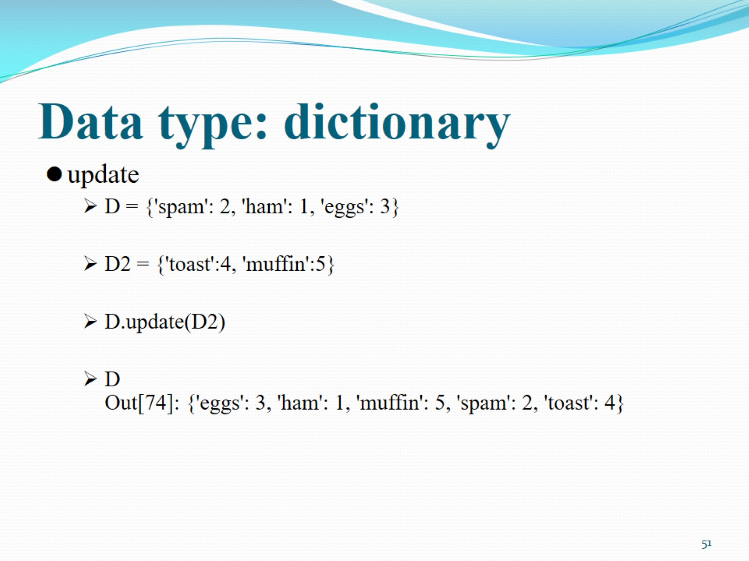
Data type: dictionary

Slide 52

Data type: dictionary

Slide 53

Outline

Slide 54

File operations

Slide 55

Using files

Slide 56

Using files

Slide 57

Storing Python Objects in Files: Conversions

Slide 58

File formats in data science

Slide 59

File formats in data science

Slide 60

File formats in data science

Slide 61

Outline

Slide 62

Loops

Slide 63

Loops: if

Slide 64

Code indentation

Slide 65

A few exceptions

Slide 66

Loops: while

Slide 67

Loops: while

Slide 68

Loops: for

Slide 69

Loops: for

Slide 70

Loops: for

Slide 71

Loops: for

Slide 72

Loops: for

Slide 73

Outline

Slide 74

Function

Slide 75

Function

Slide 76

Outline

Slide 77

Example: loading data matrix

Slide 78

Example: loading data matrix

Slide 79

Example: loading data matrix

Slide 80

Example: t-test

Slide 81

Example: t-test data

Slide 82

Data science: Python vs R

Slide 83

Data science: Python vs R

Slide 84

Data science: Python vs R

